Slide 1


Models and illustrations from the book
‘Hello $Firstname’

Slide 2

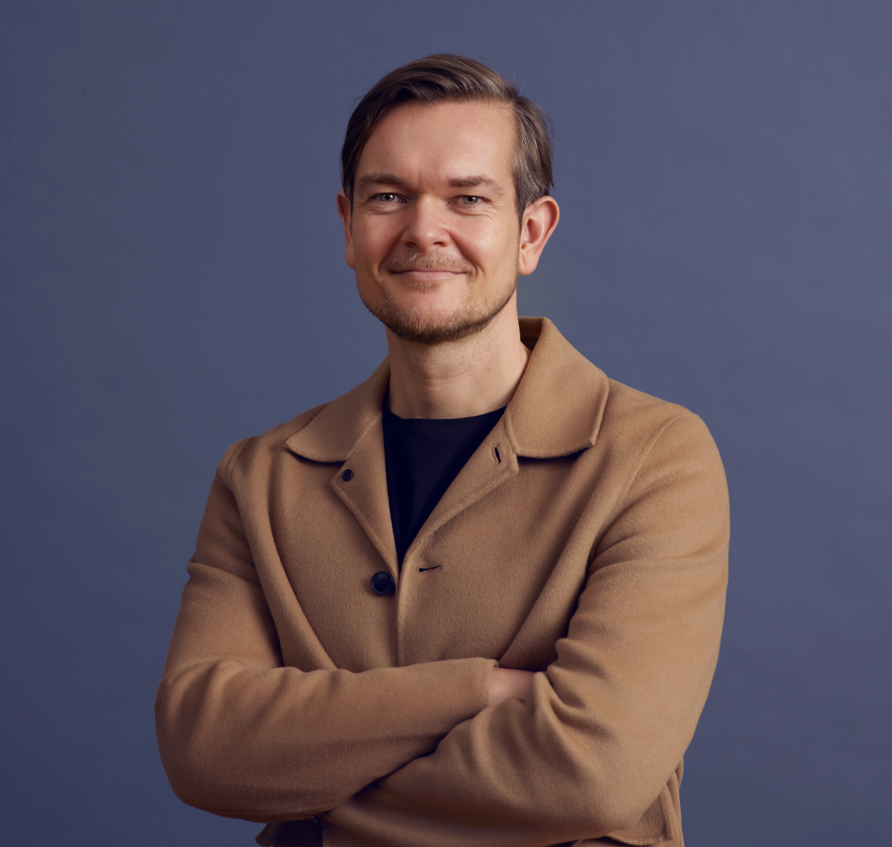

About the author
Rasmus Houlind
Author and founder of Omnichannel Institute
Chief Experience Officer at Agillic
Author:
”Hello $Firstname: Profiting from Personalization ” (2023)
”Make it all about me” (2019)
”Hvis det handler om mig, så køber jeg!” (2015)
linkedin.com/in/houlind
rasmus@omnichannelinstitute.com
+45 53 886 555

Slide 3
A note from the author
The cornerstone of my authorship has always been to make the complexity of modern marketing comprehensible for the marketers who are actually there in the trenches making it happen. That’s why I always strive to develop models to quickly and efficiently enable an understanding of complex topics.
Modern marketers struggle with communicating with top level management on the one hand and actually getting real marketing working on the other. And it’s never a one-man-task. Teams who share the same mental images and use the same terms for their work are able to have unambiguous yet nuanced conversations about personalized marketing and customer experiences. That’s a fundamental part of marketing success.
This document includes all the models used in the book ‘Hello $Firstname – Profiting from Personalization’. I encourage you to use and share these models with your teams, your colleagues and your friends. My only ask is that you please reference the book whenever you are doing so.
Rasmus Houlind, Copenhagen 2023

Slide 4
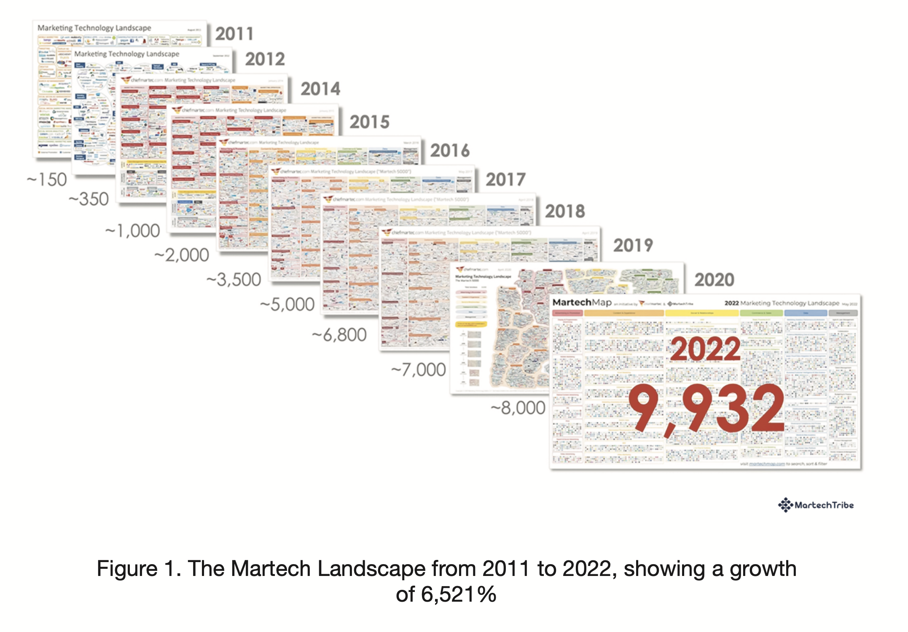

Slide 5
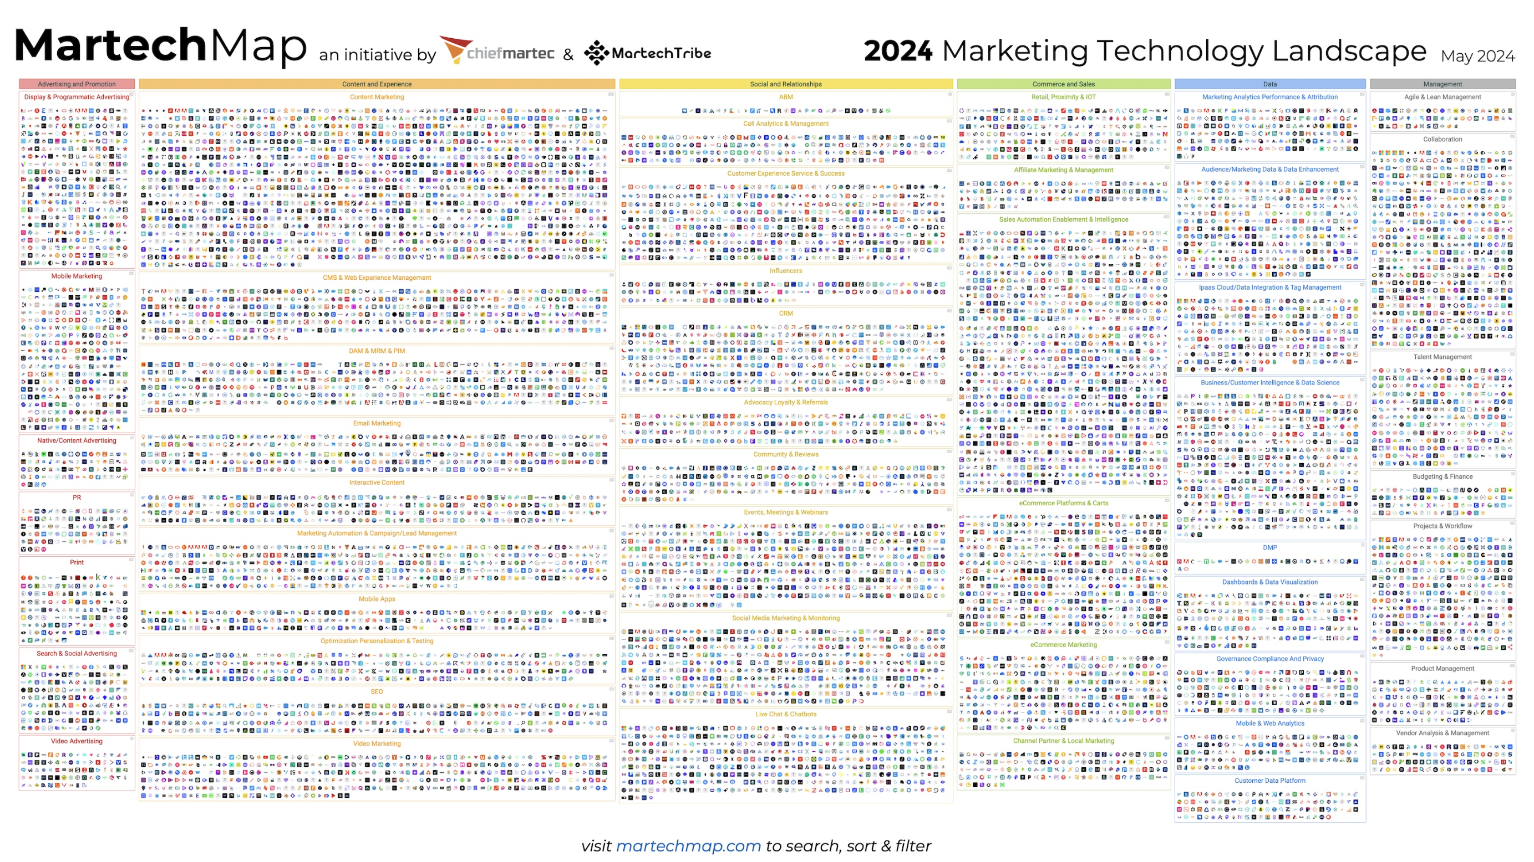
14,106 martech products (27.8% growth YoY)

Slide 6
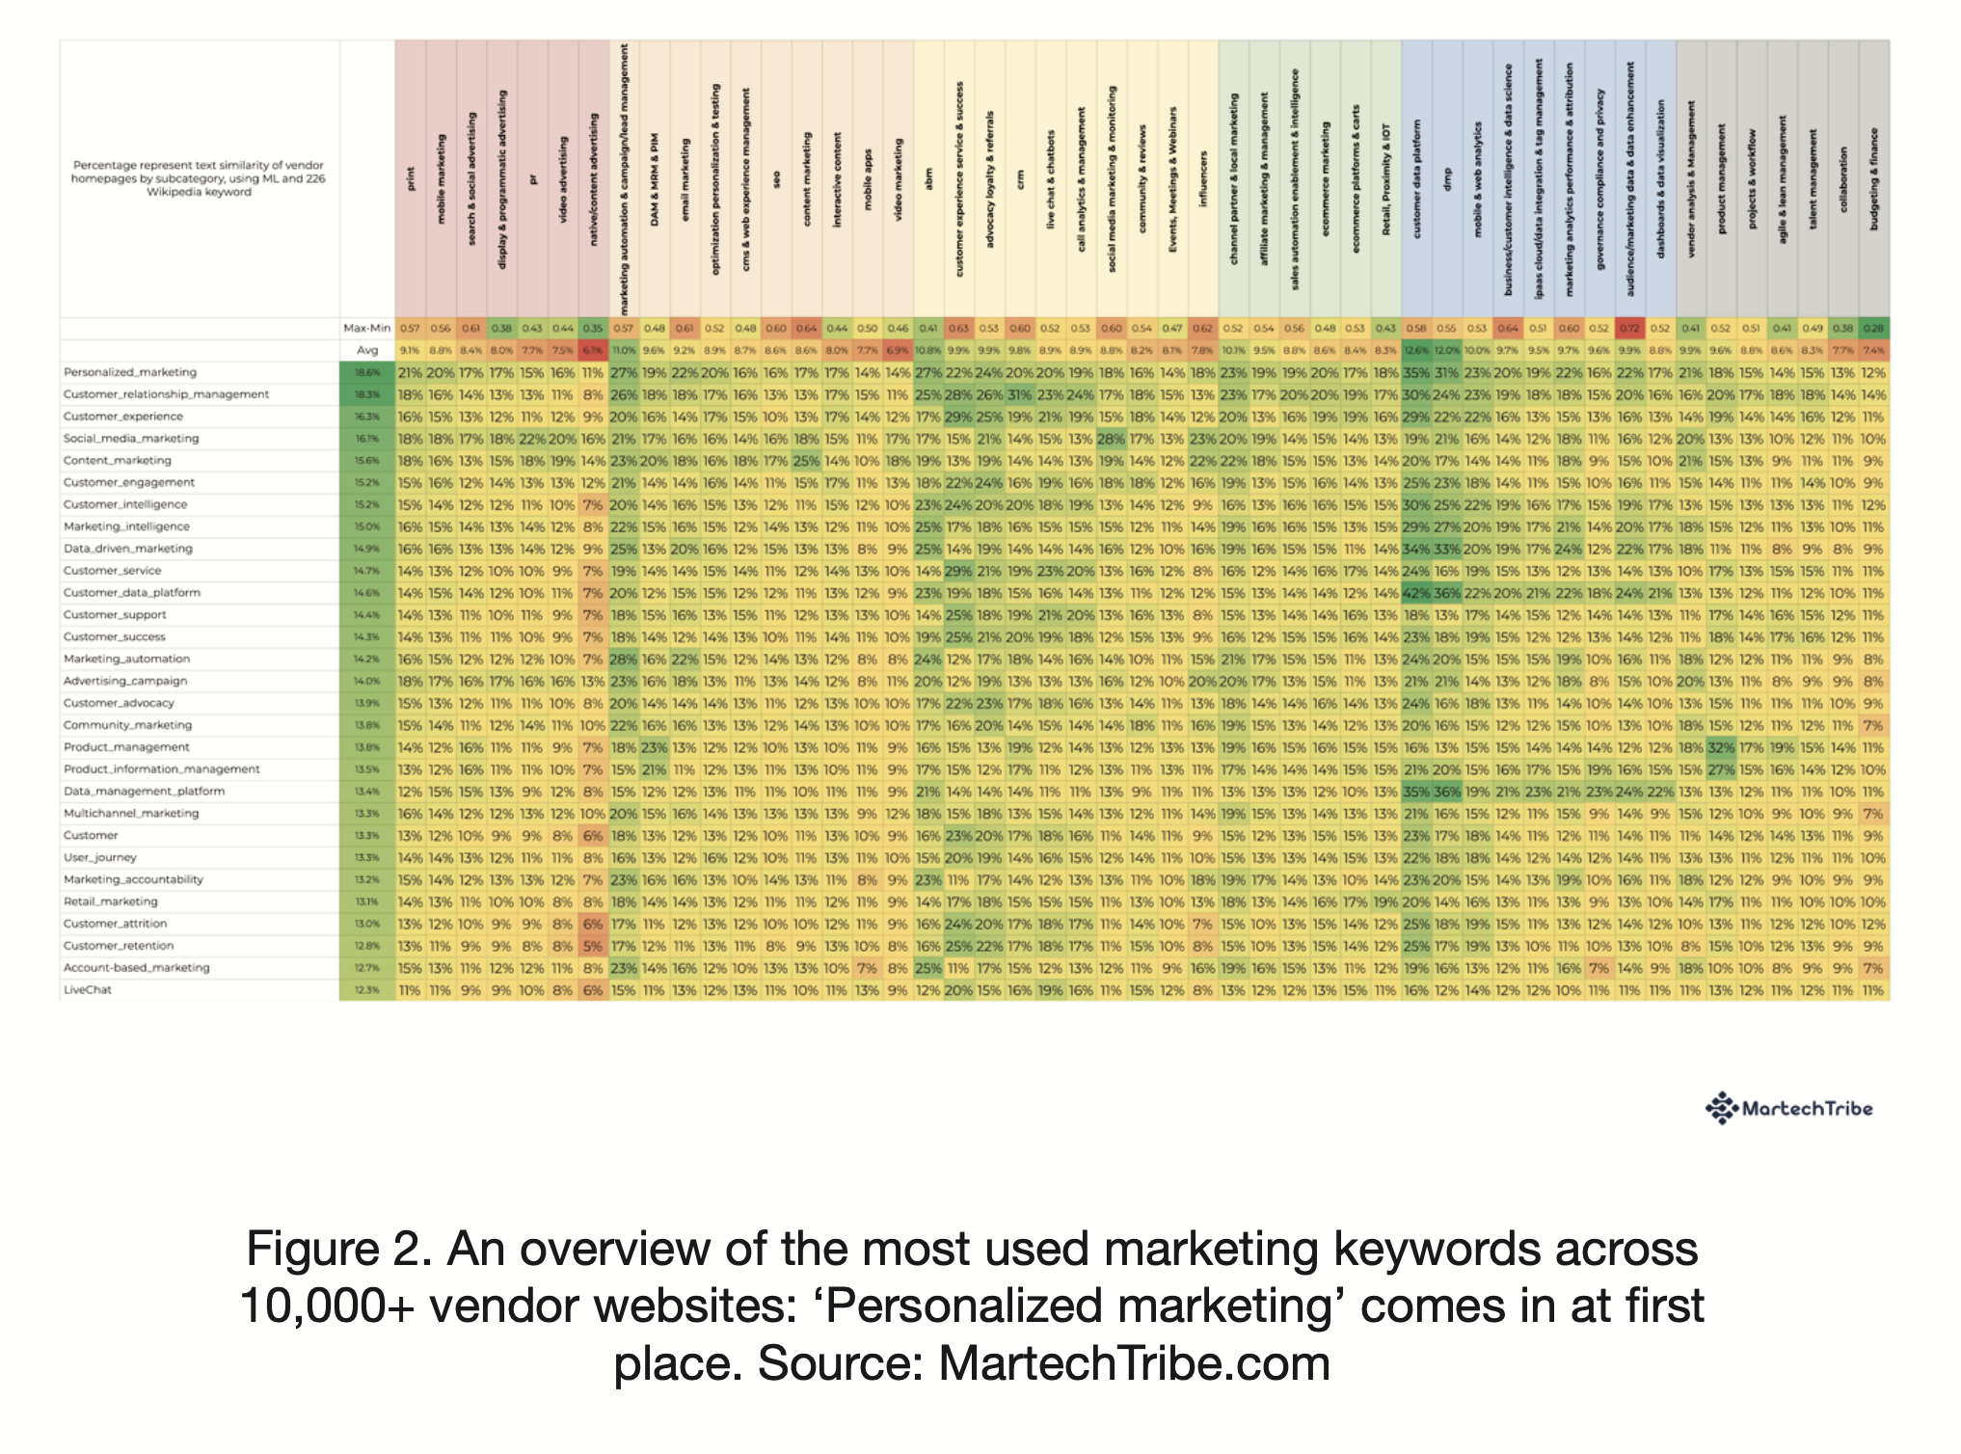

Slide 7
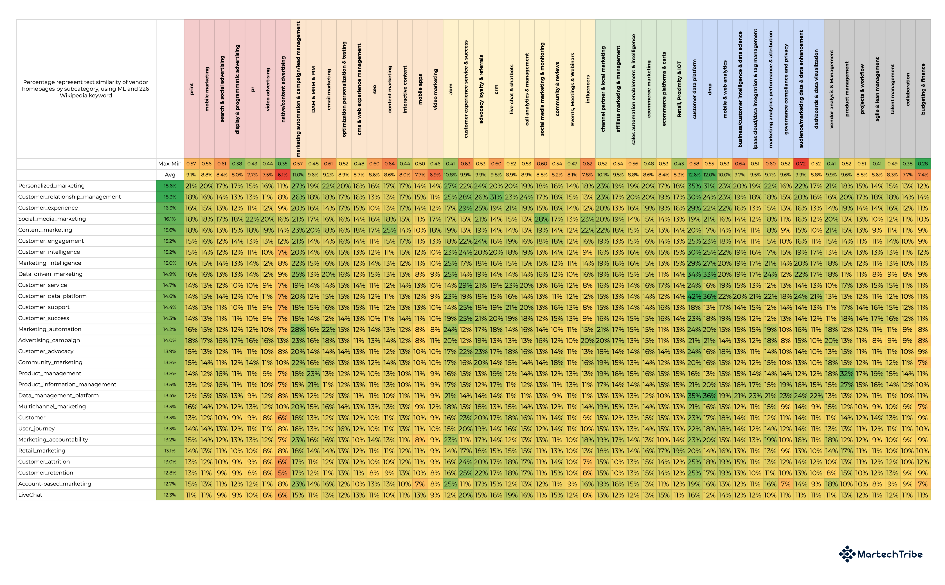

Slide 8
The hype is on!
Figure 2. An overview of the most used marketing keywords across 10,000+ vendor websites: ‘Personalized marketing’ comes in at first place. Source: MartechTribe.com
Notes:
How many believe they know what personalization is?
How many would be comfortable explaining it to the audience right now?

Slide 10
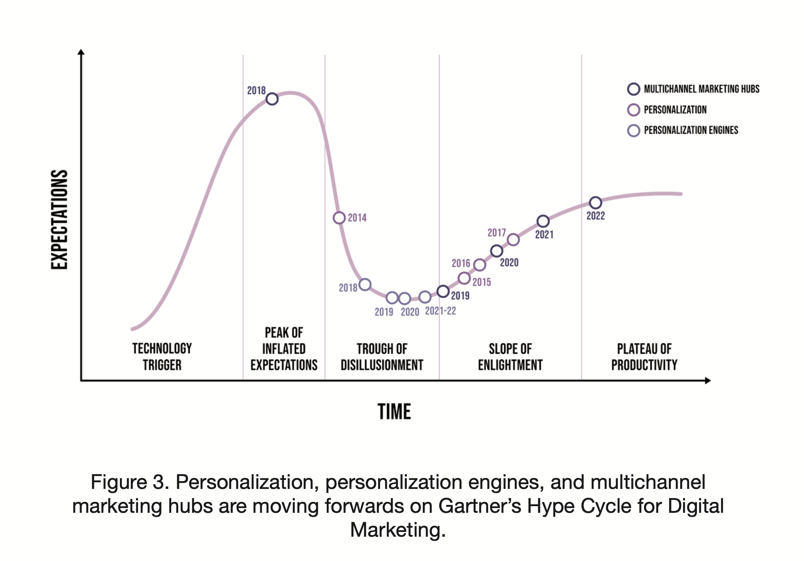

Slide 11
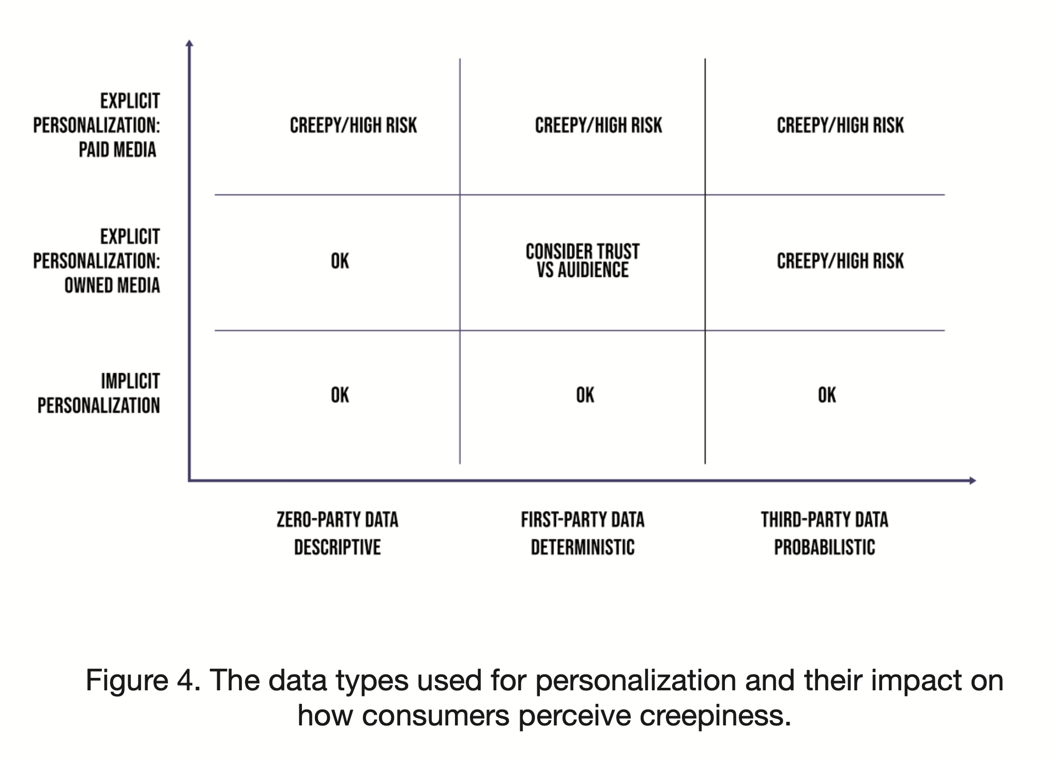

Slide 12
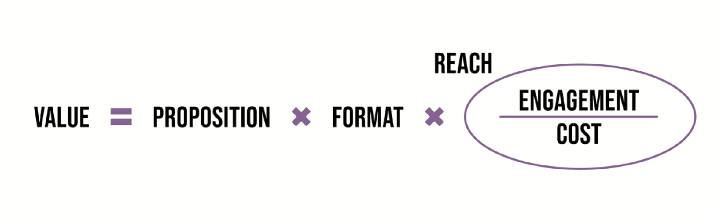
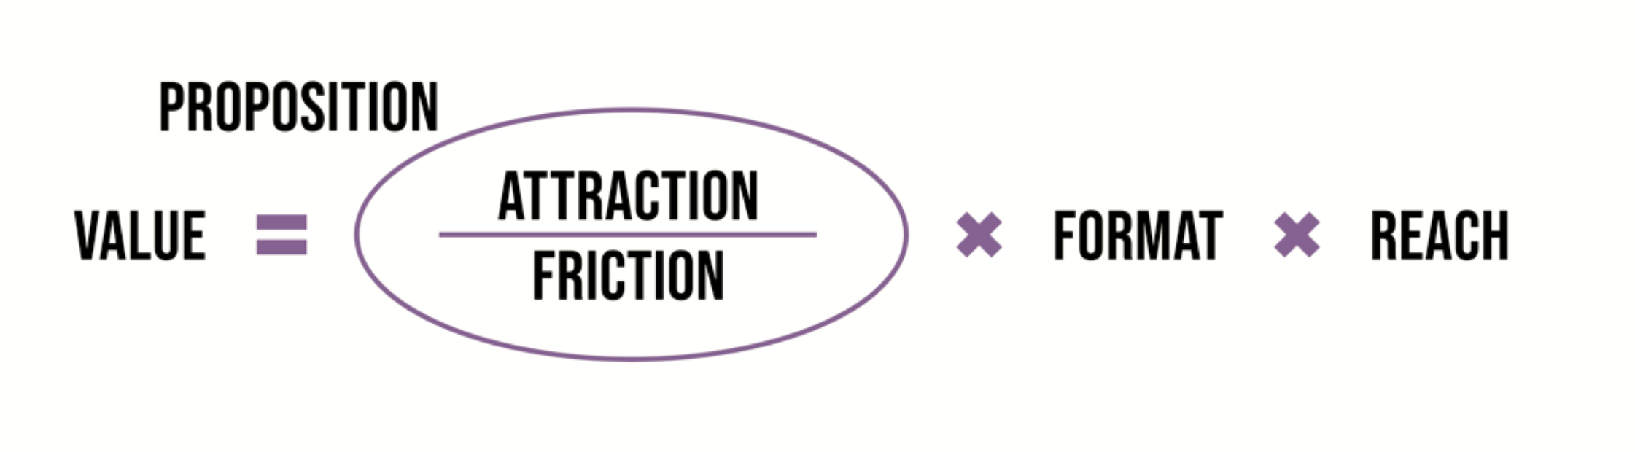



Slide 14
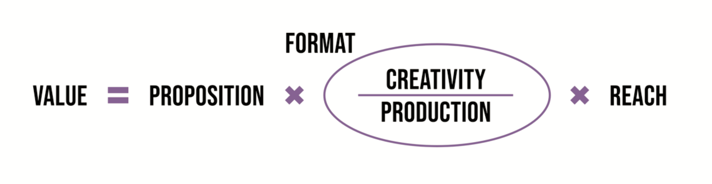

Slide 17
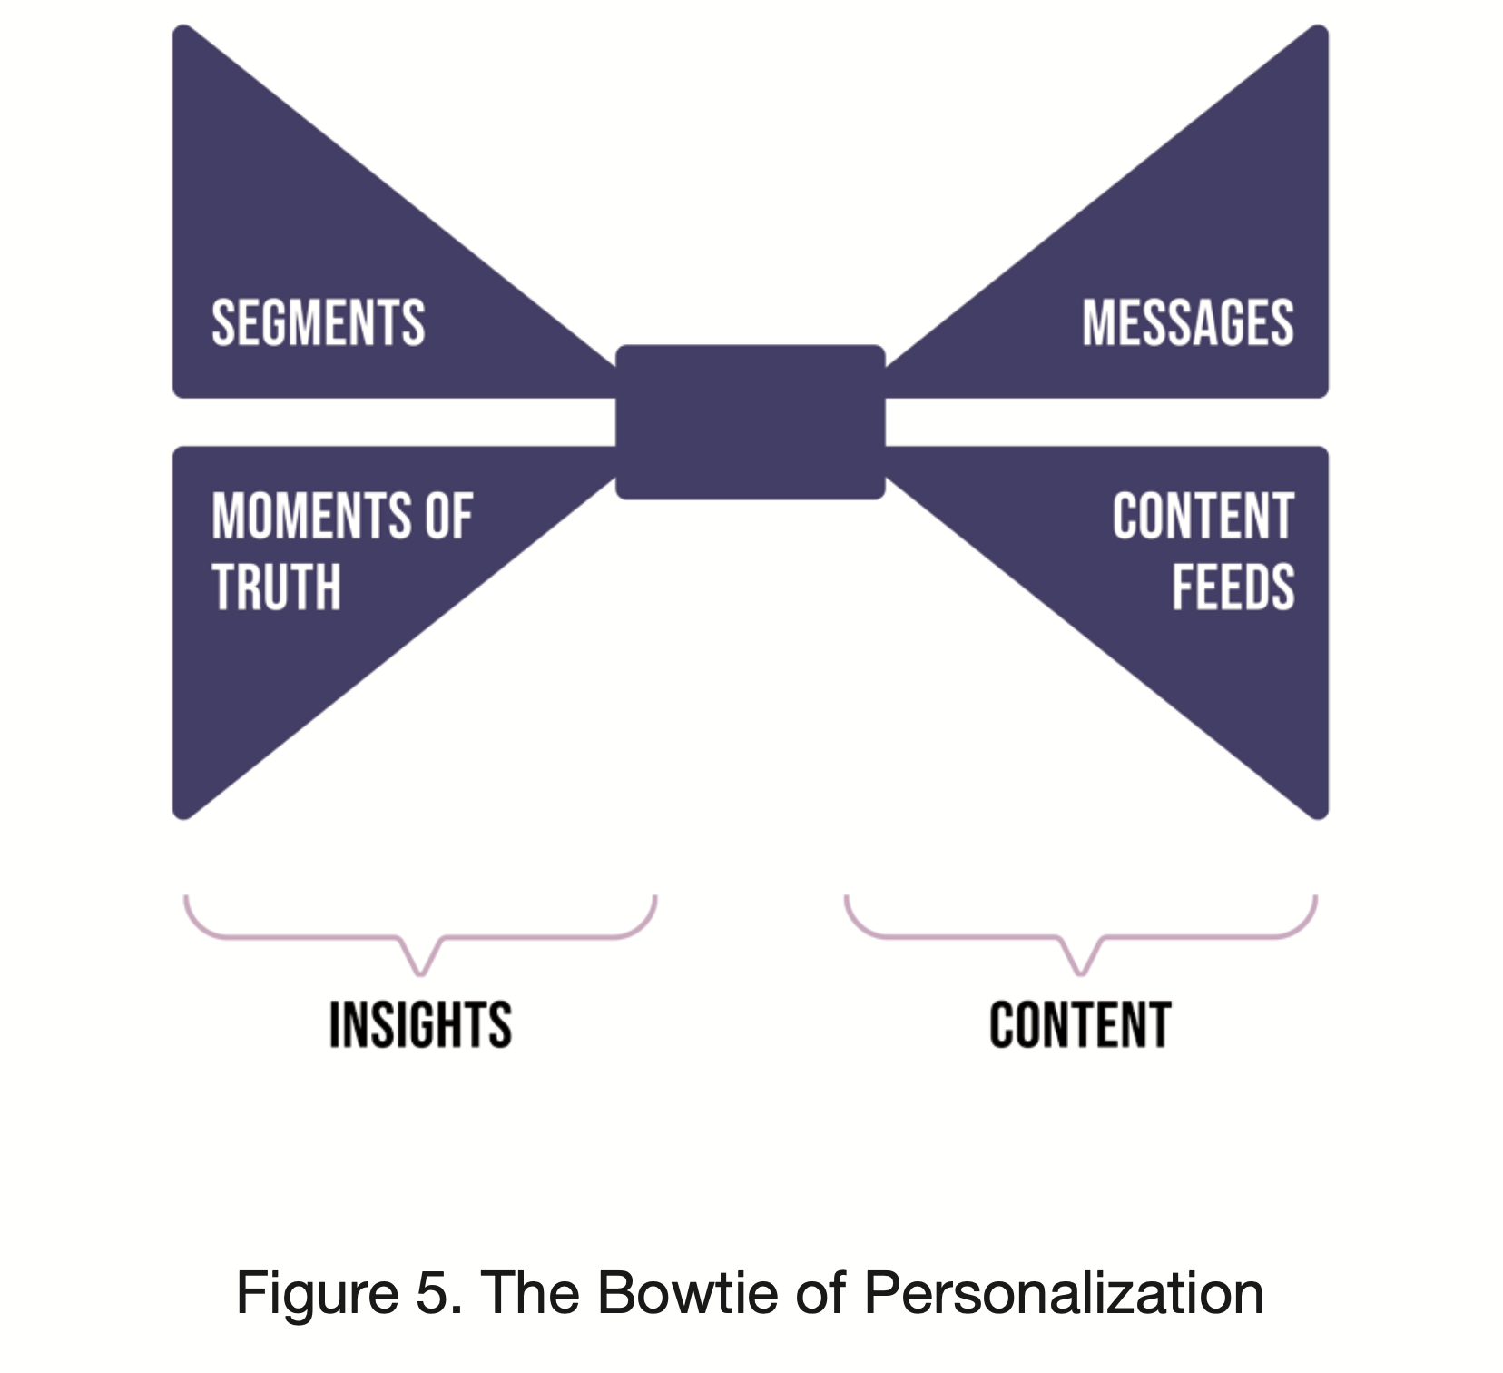

Slide 18
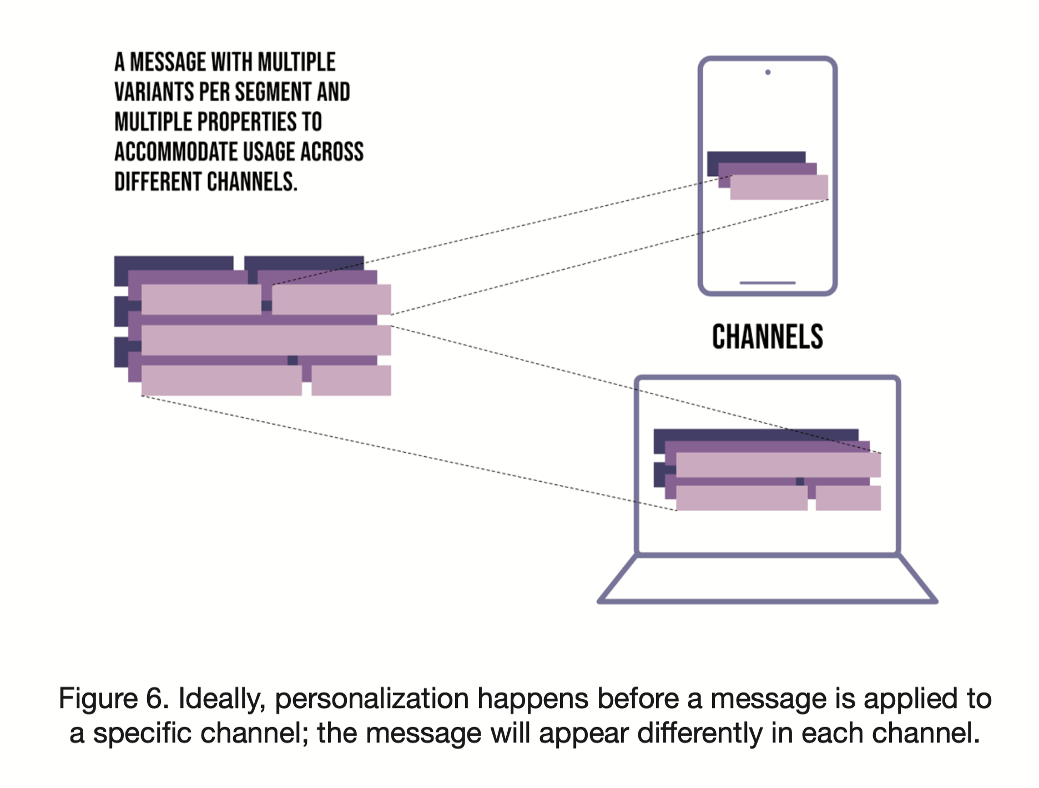

Slide 19
How many variants of a message do you need to personalize properly?
Does your martech stack support the flexible content model needed to handle this?

Slide 20
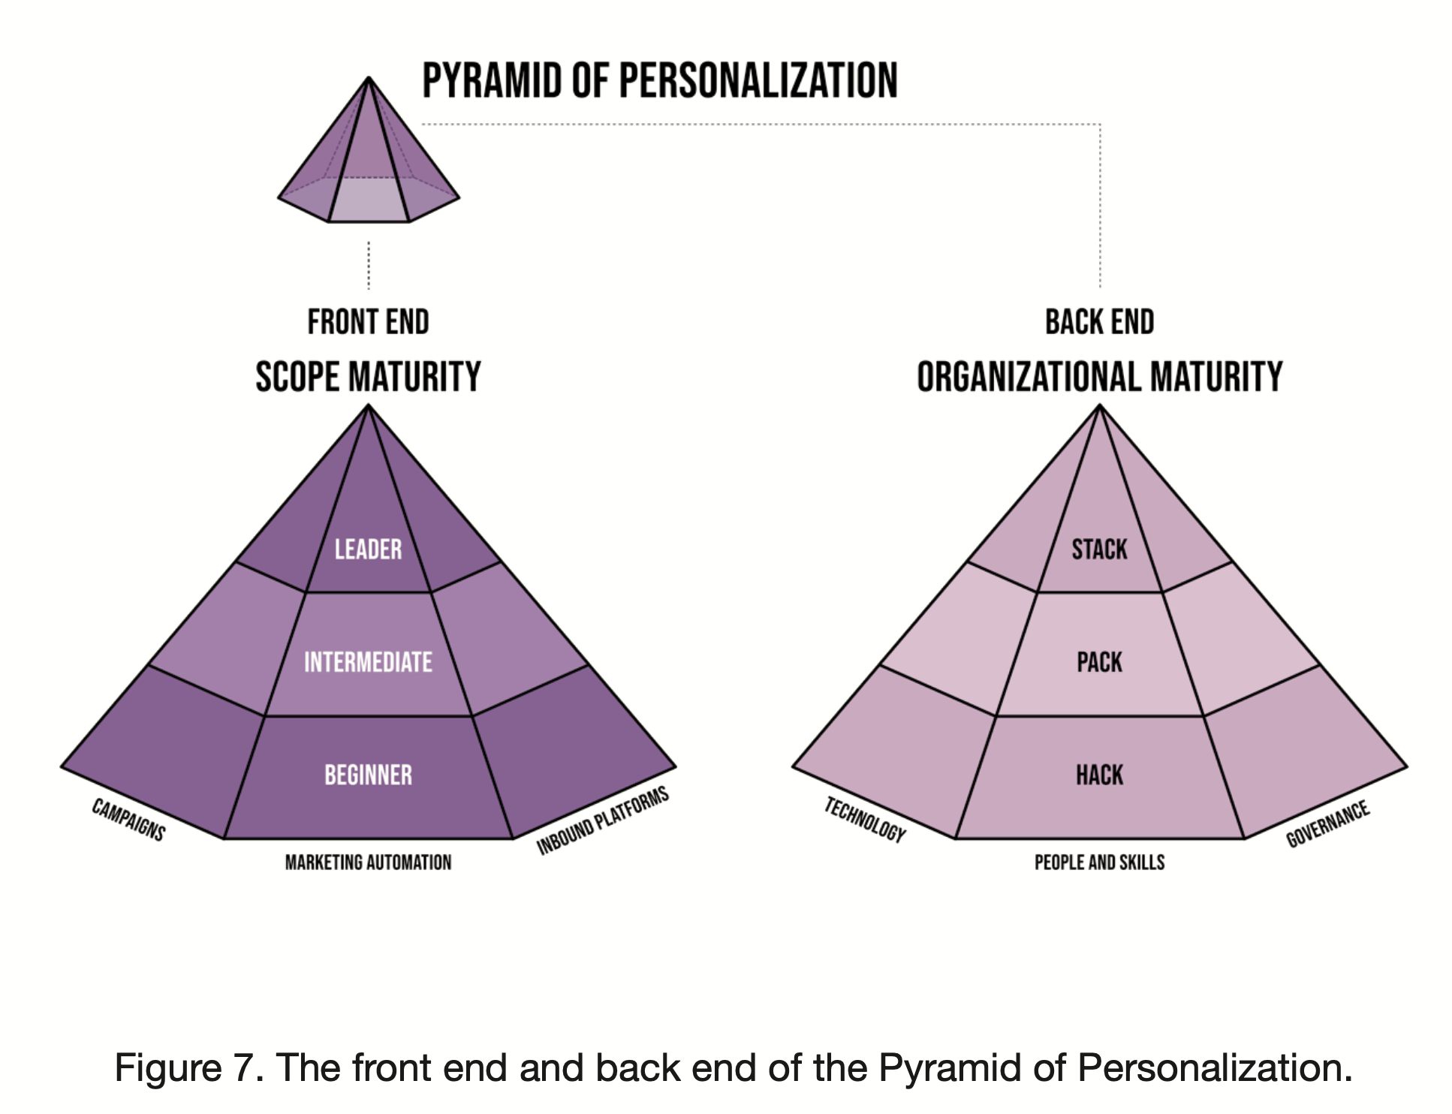

Slide 21
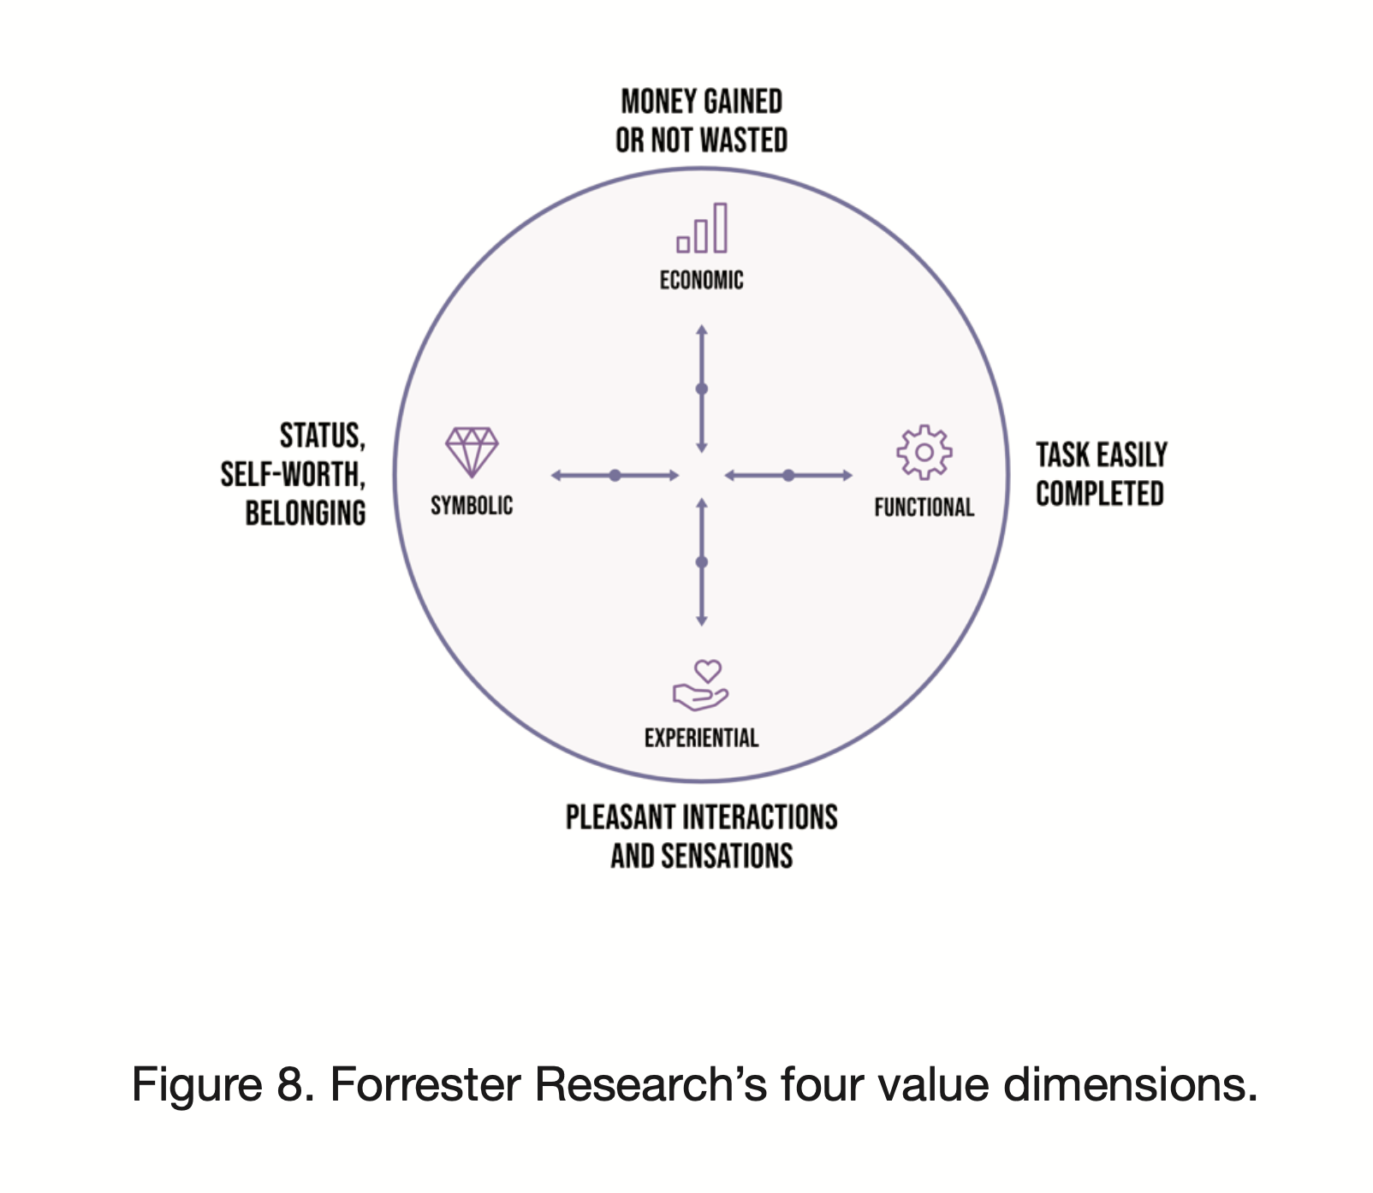

Slide 22
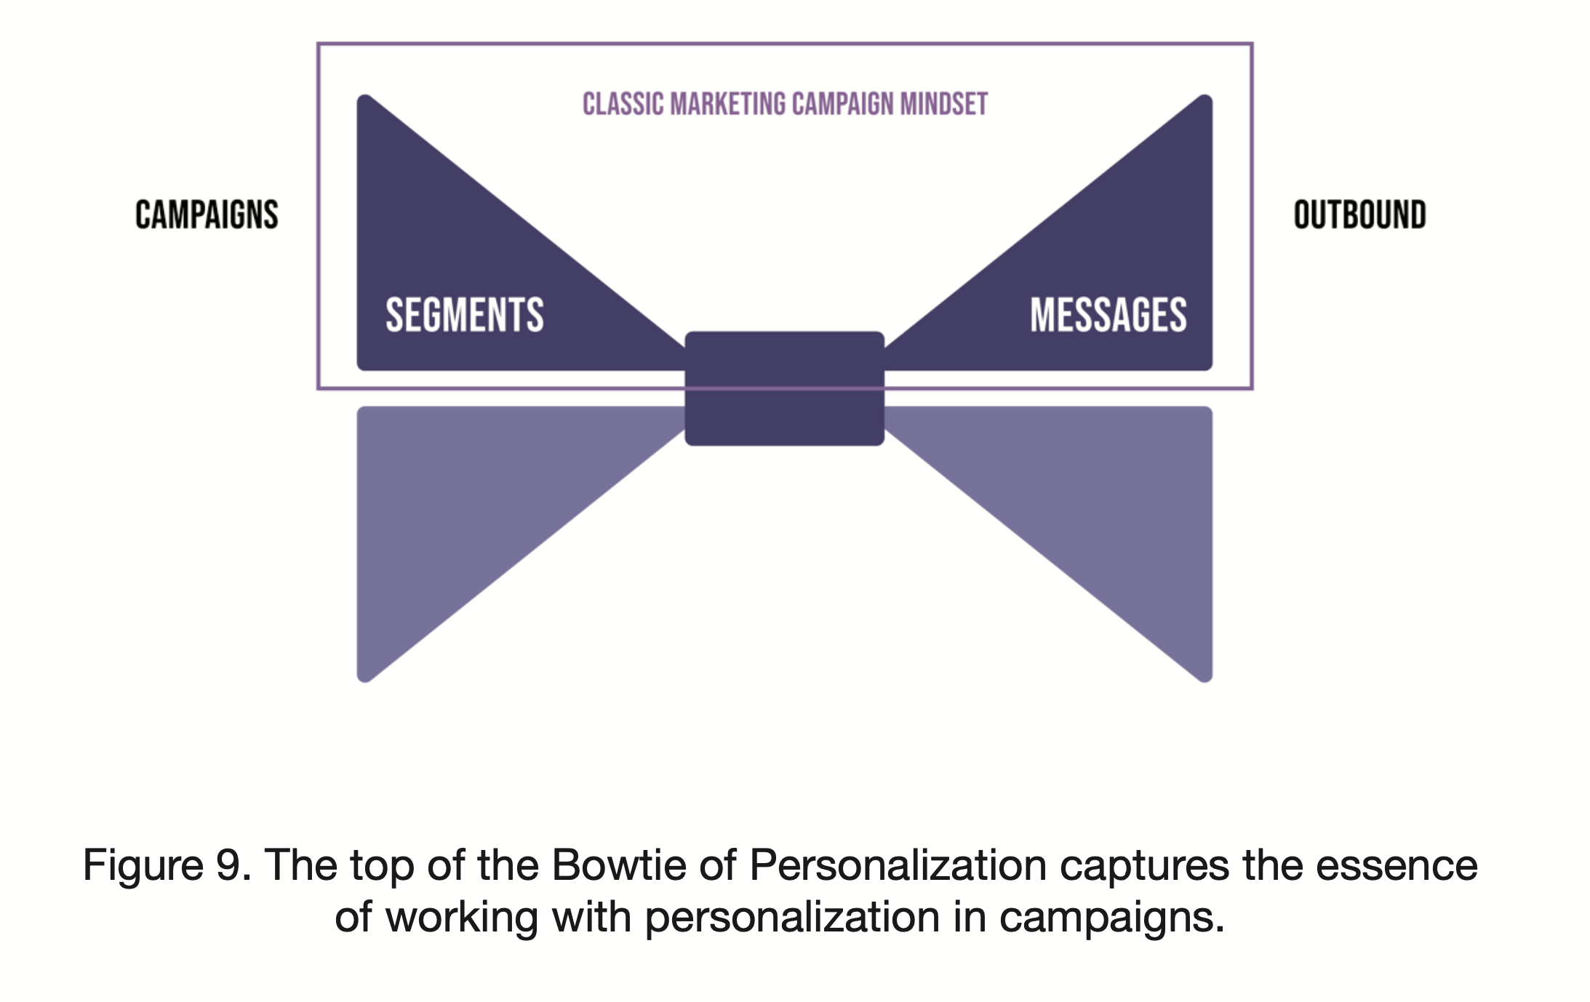

Slide 23
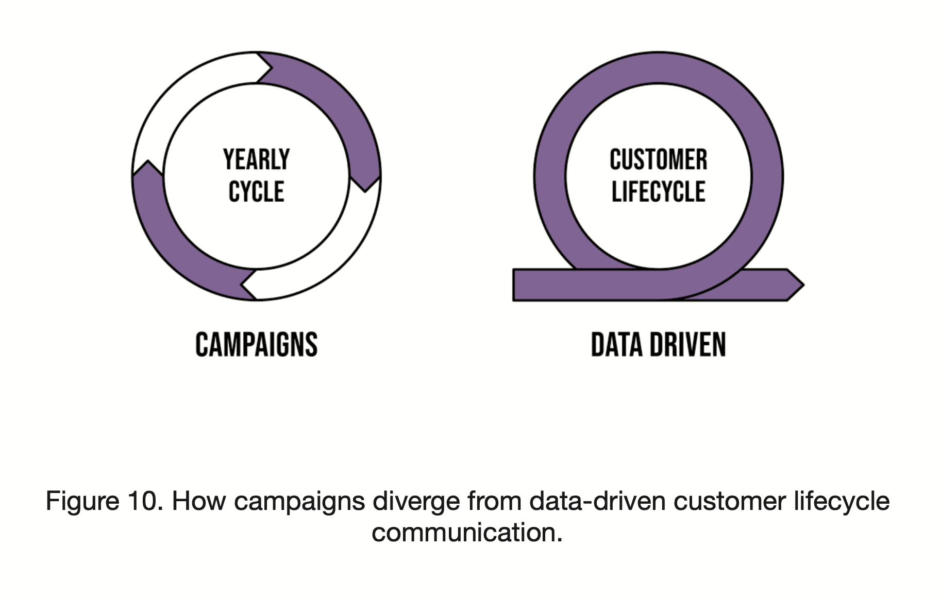

Slide 24
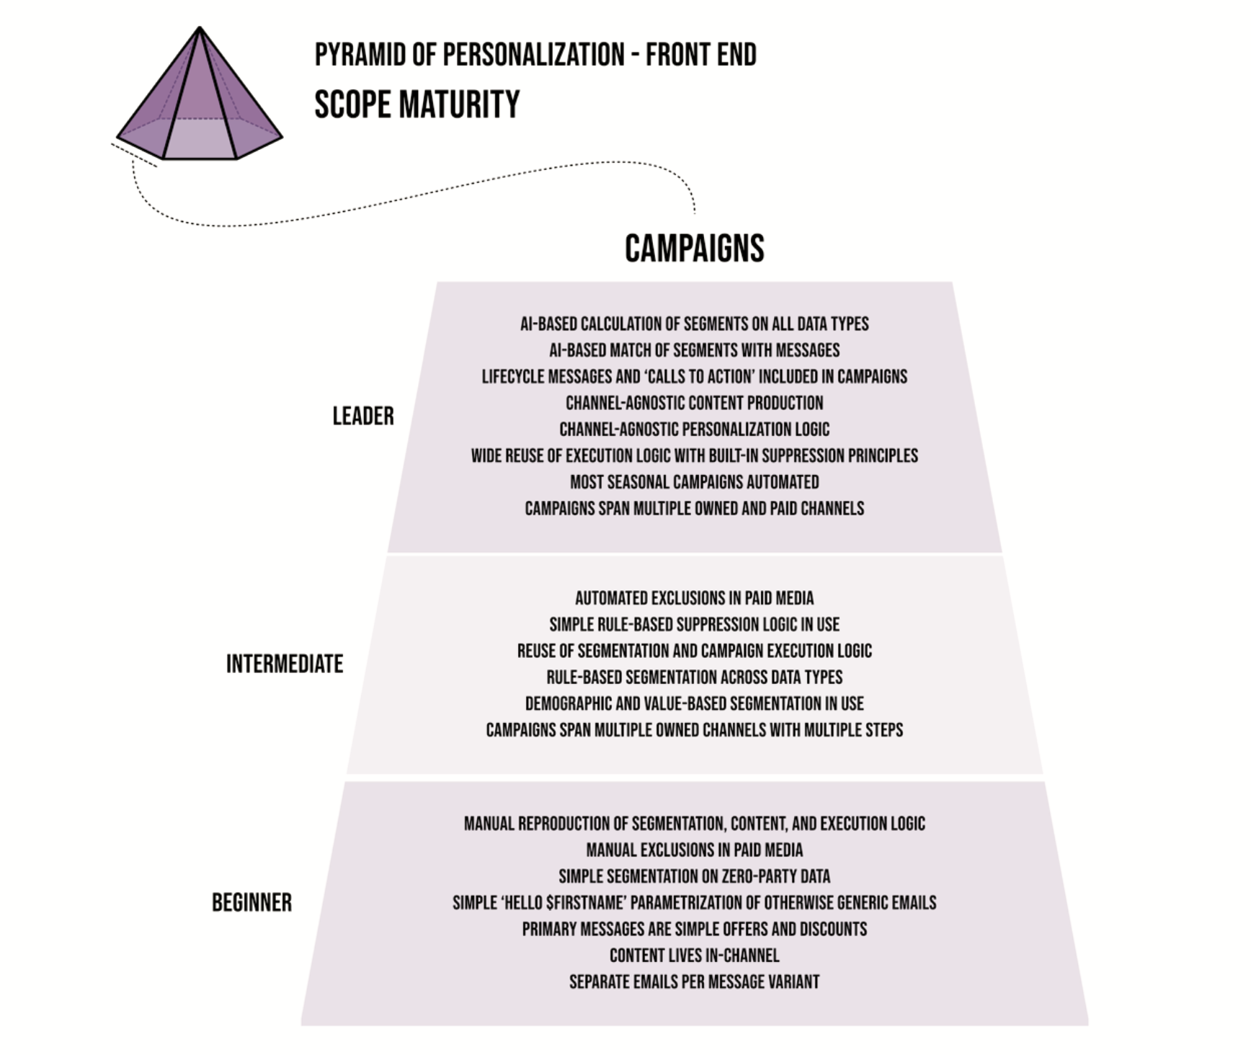

Slide 25
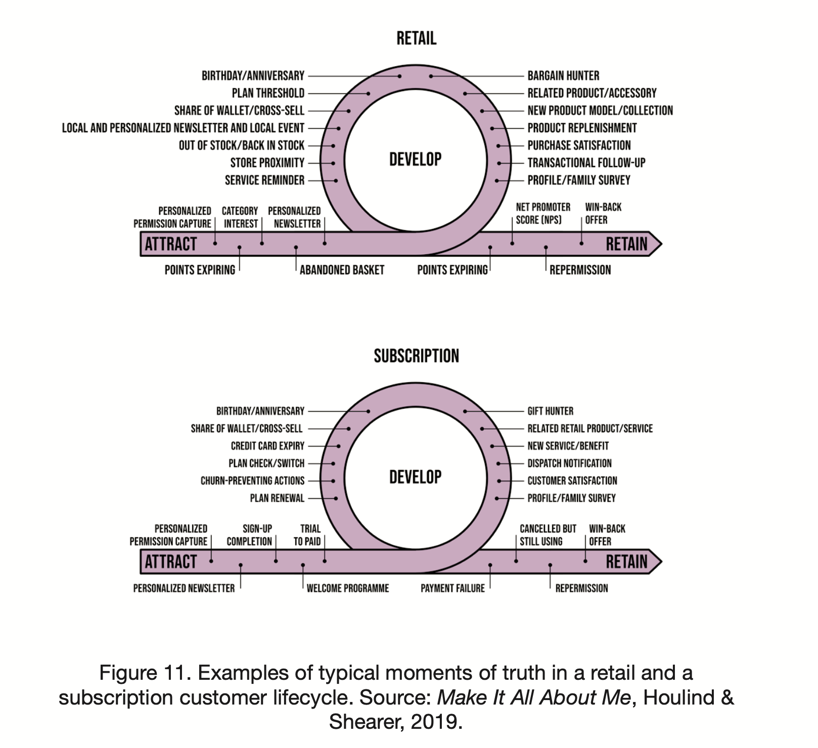

Slide 26
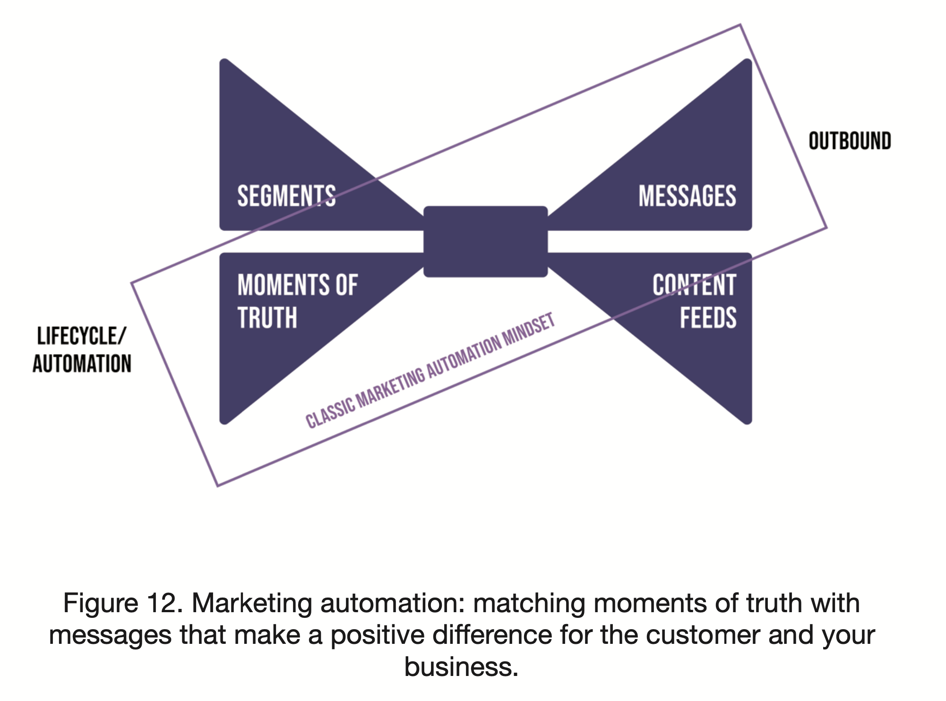

Slide 27
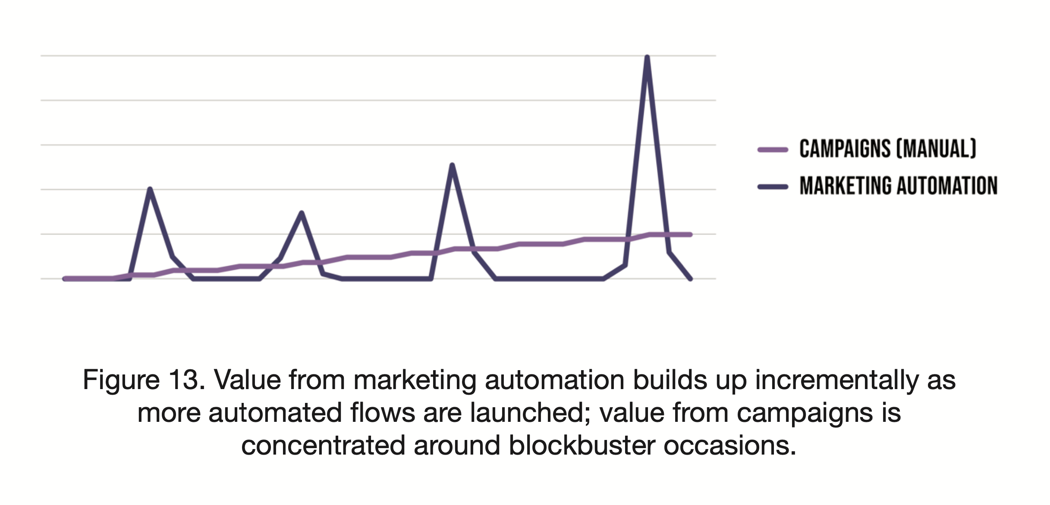

Slide 28
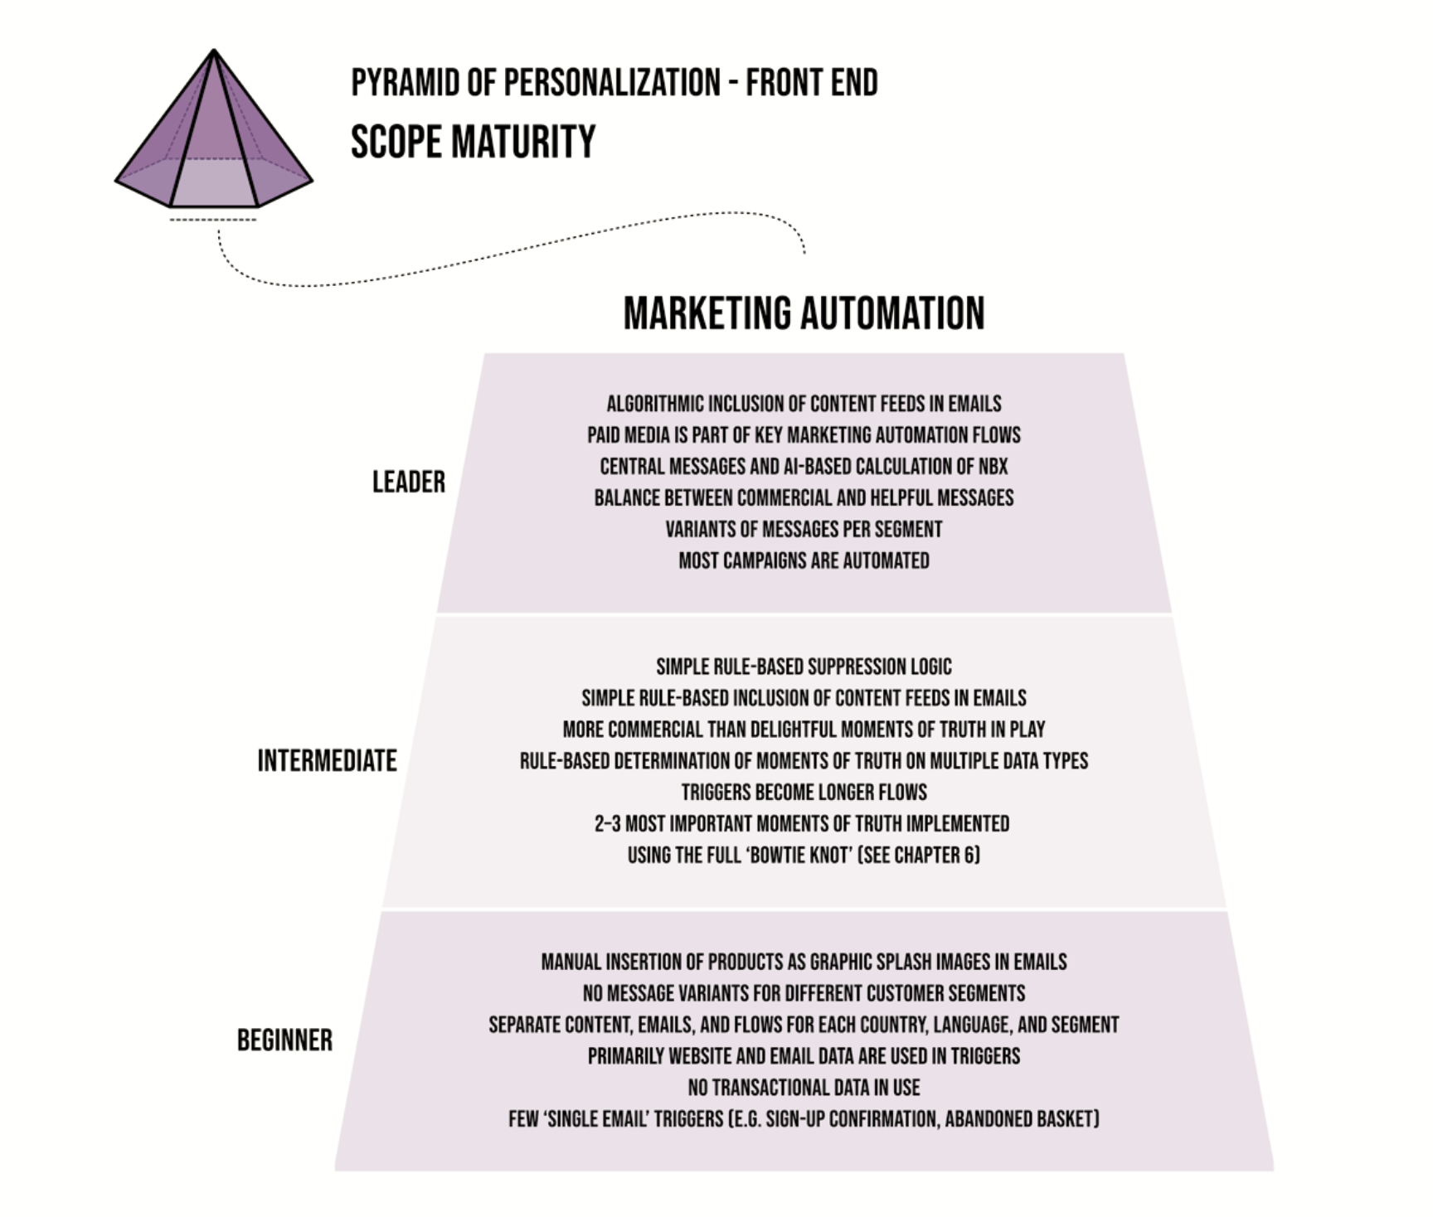

Slide 29
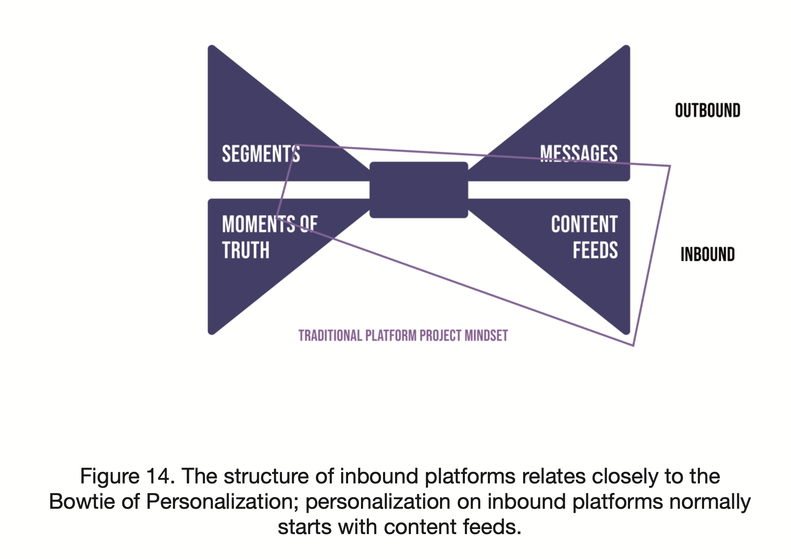

Slide 30
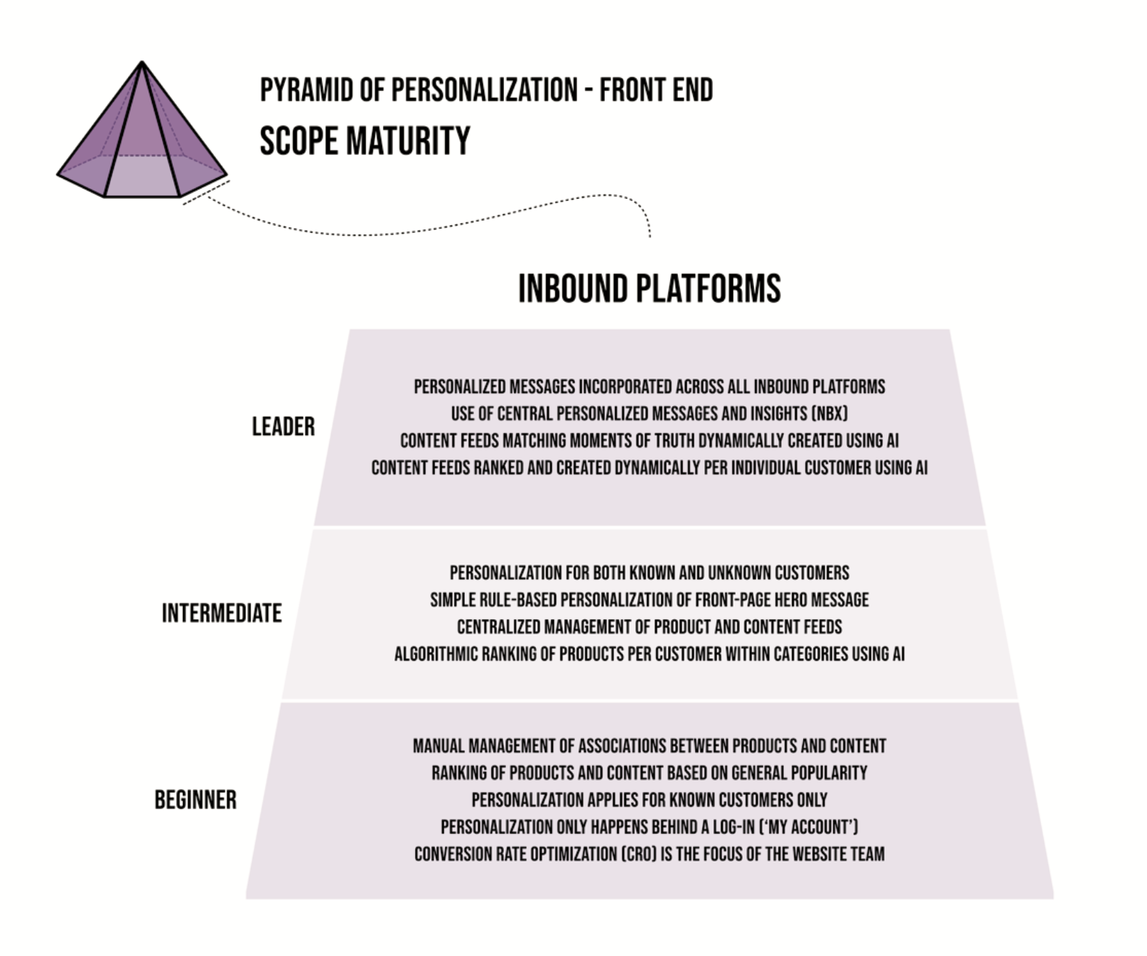

Slide 31
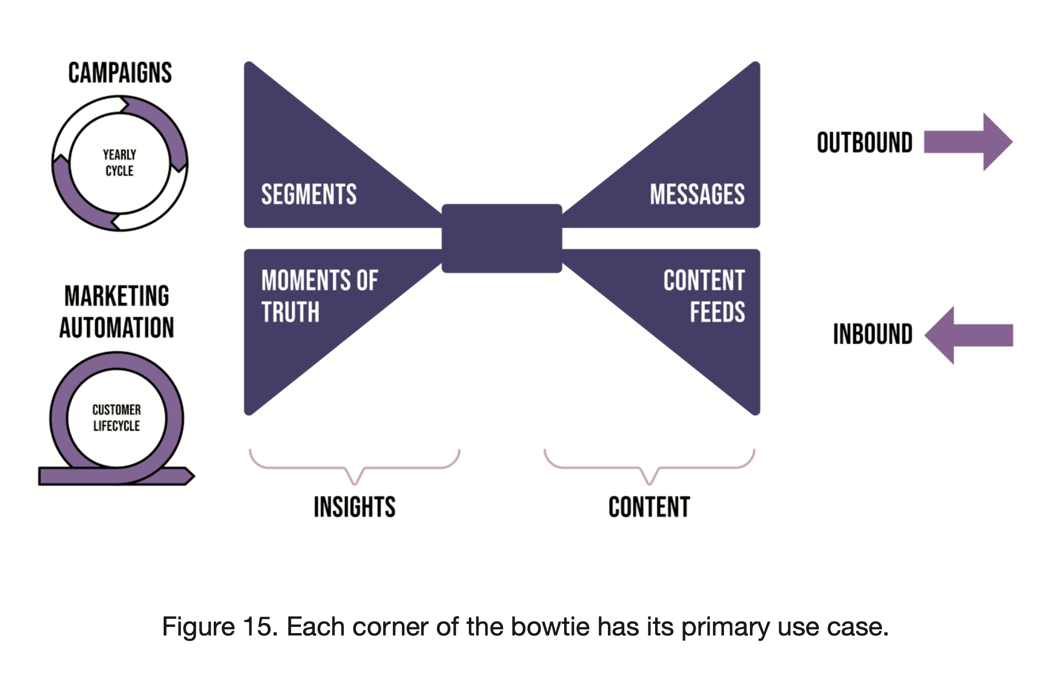

Slide 32
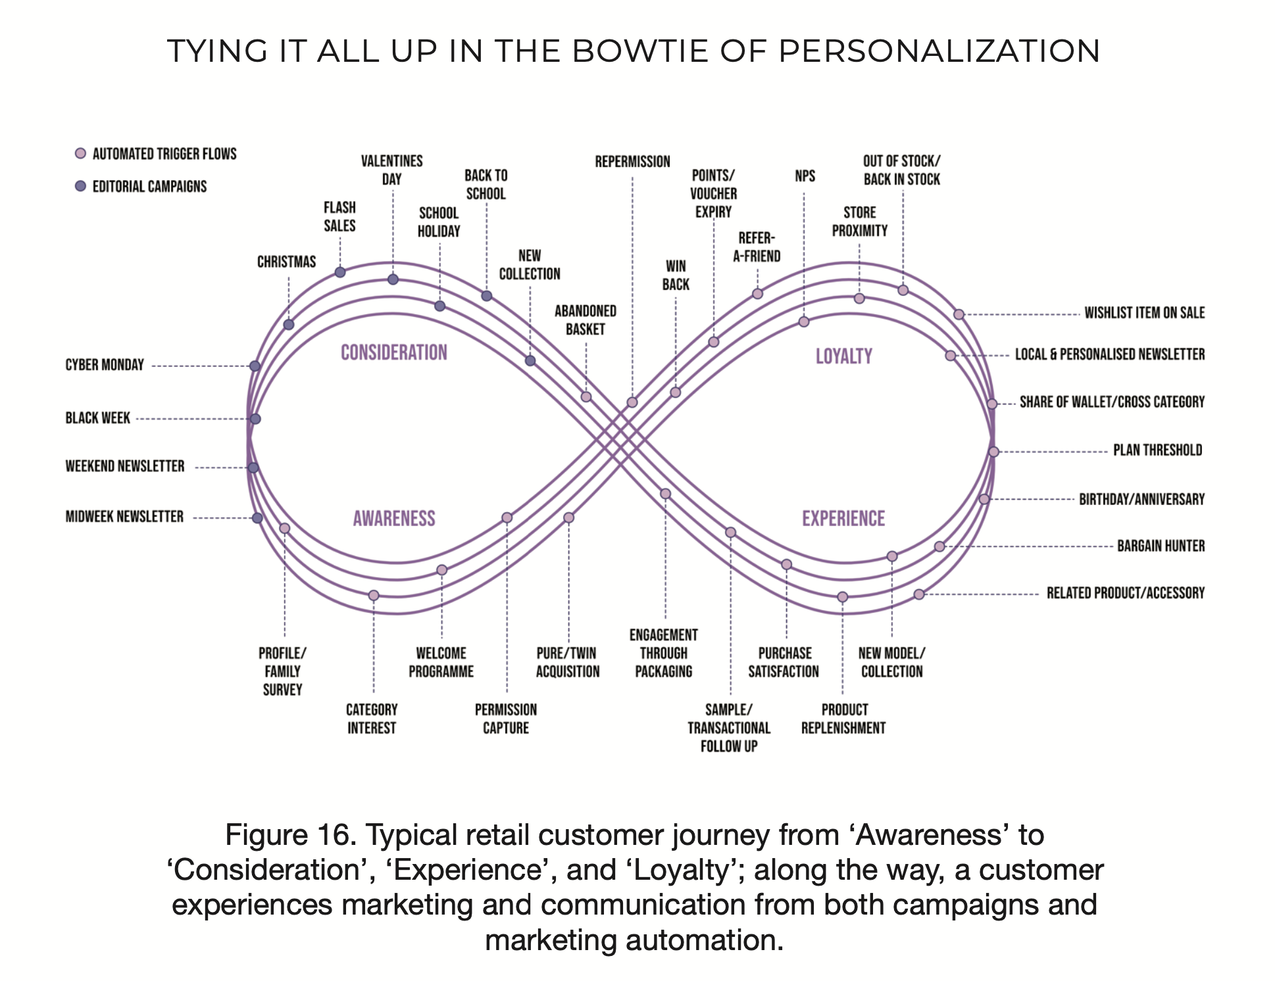

Slide 33
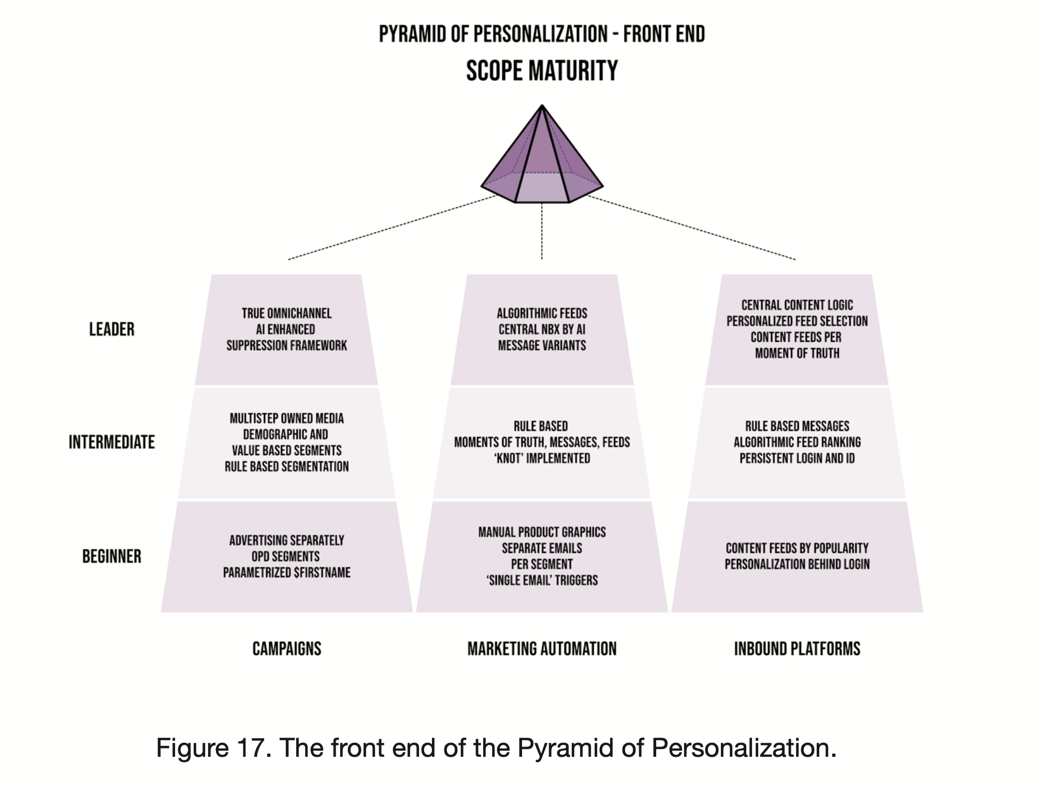

Slide 34
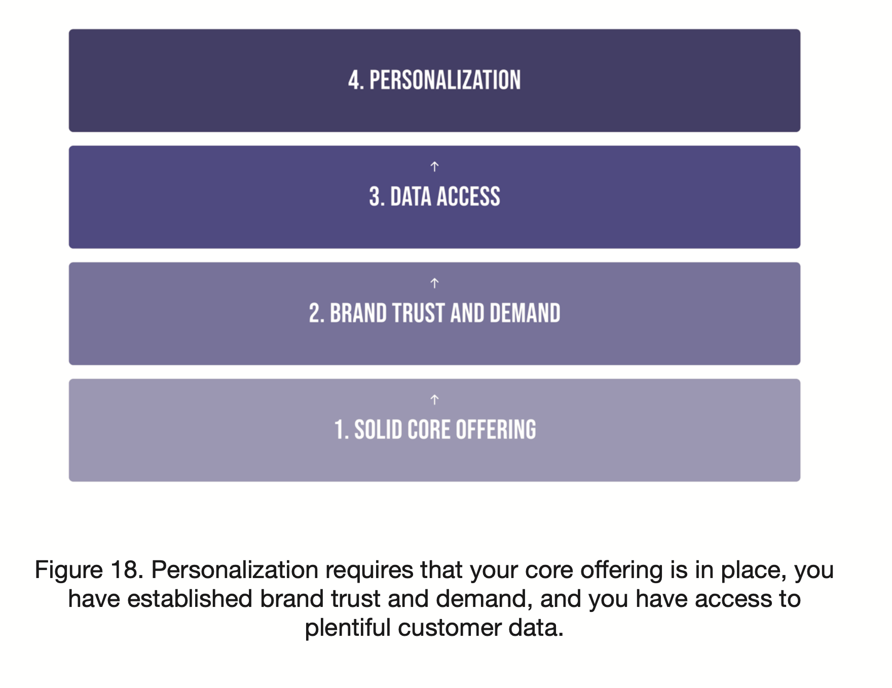

Slide 35
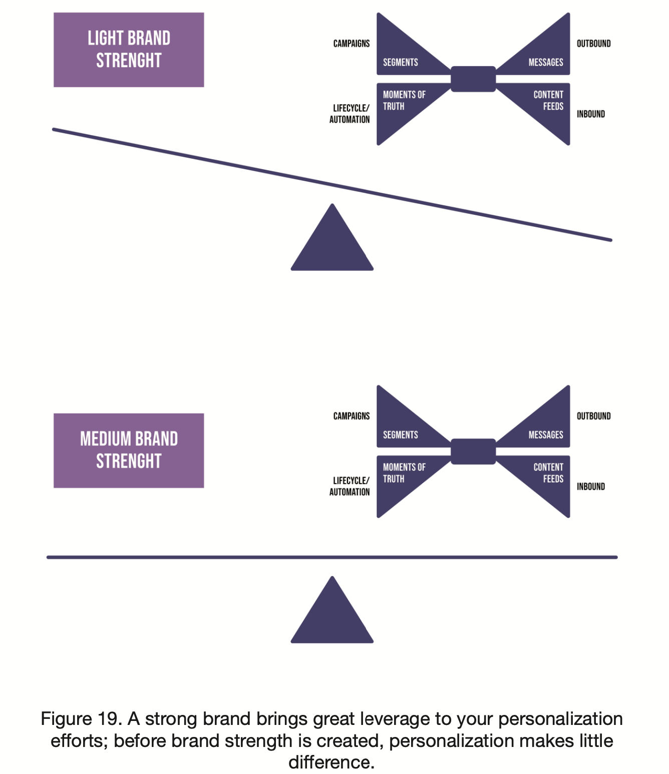

Slide 36
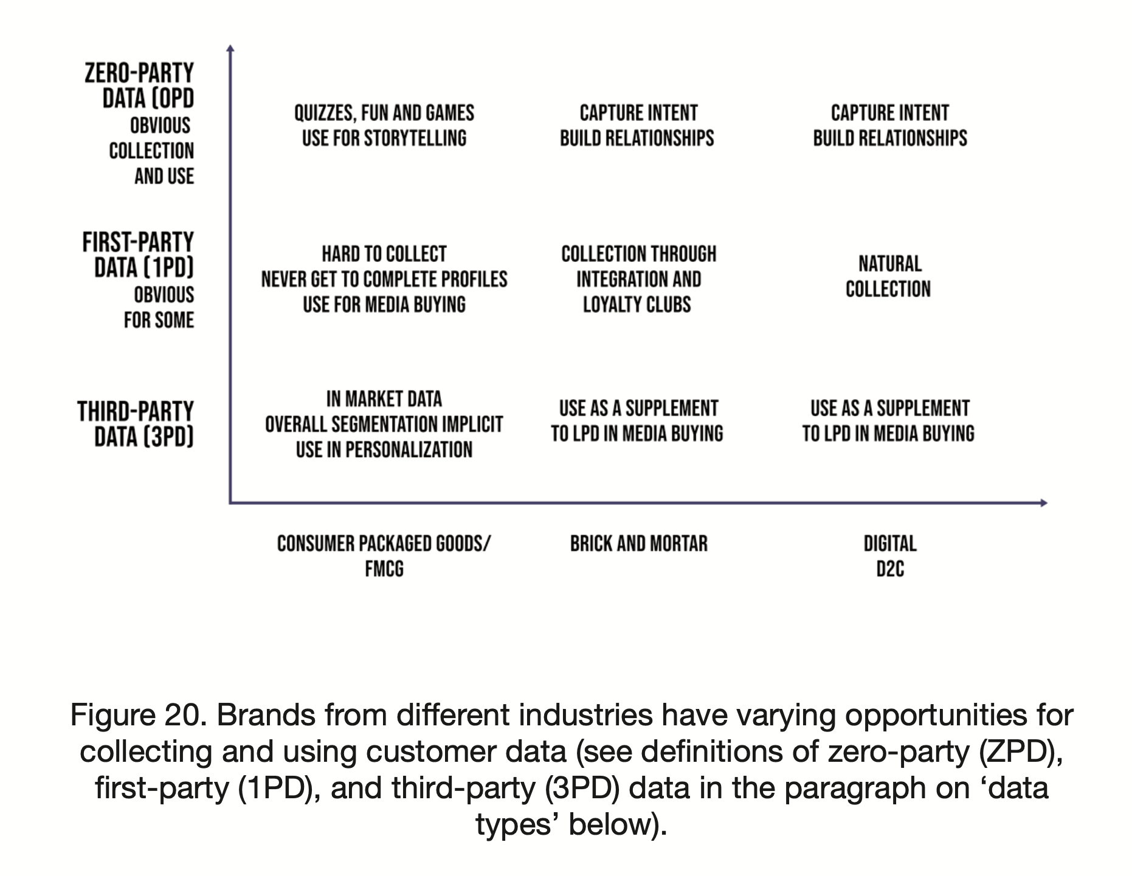

Slide 37
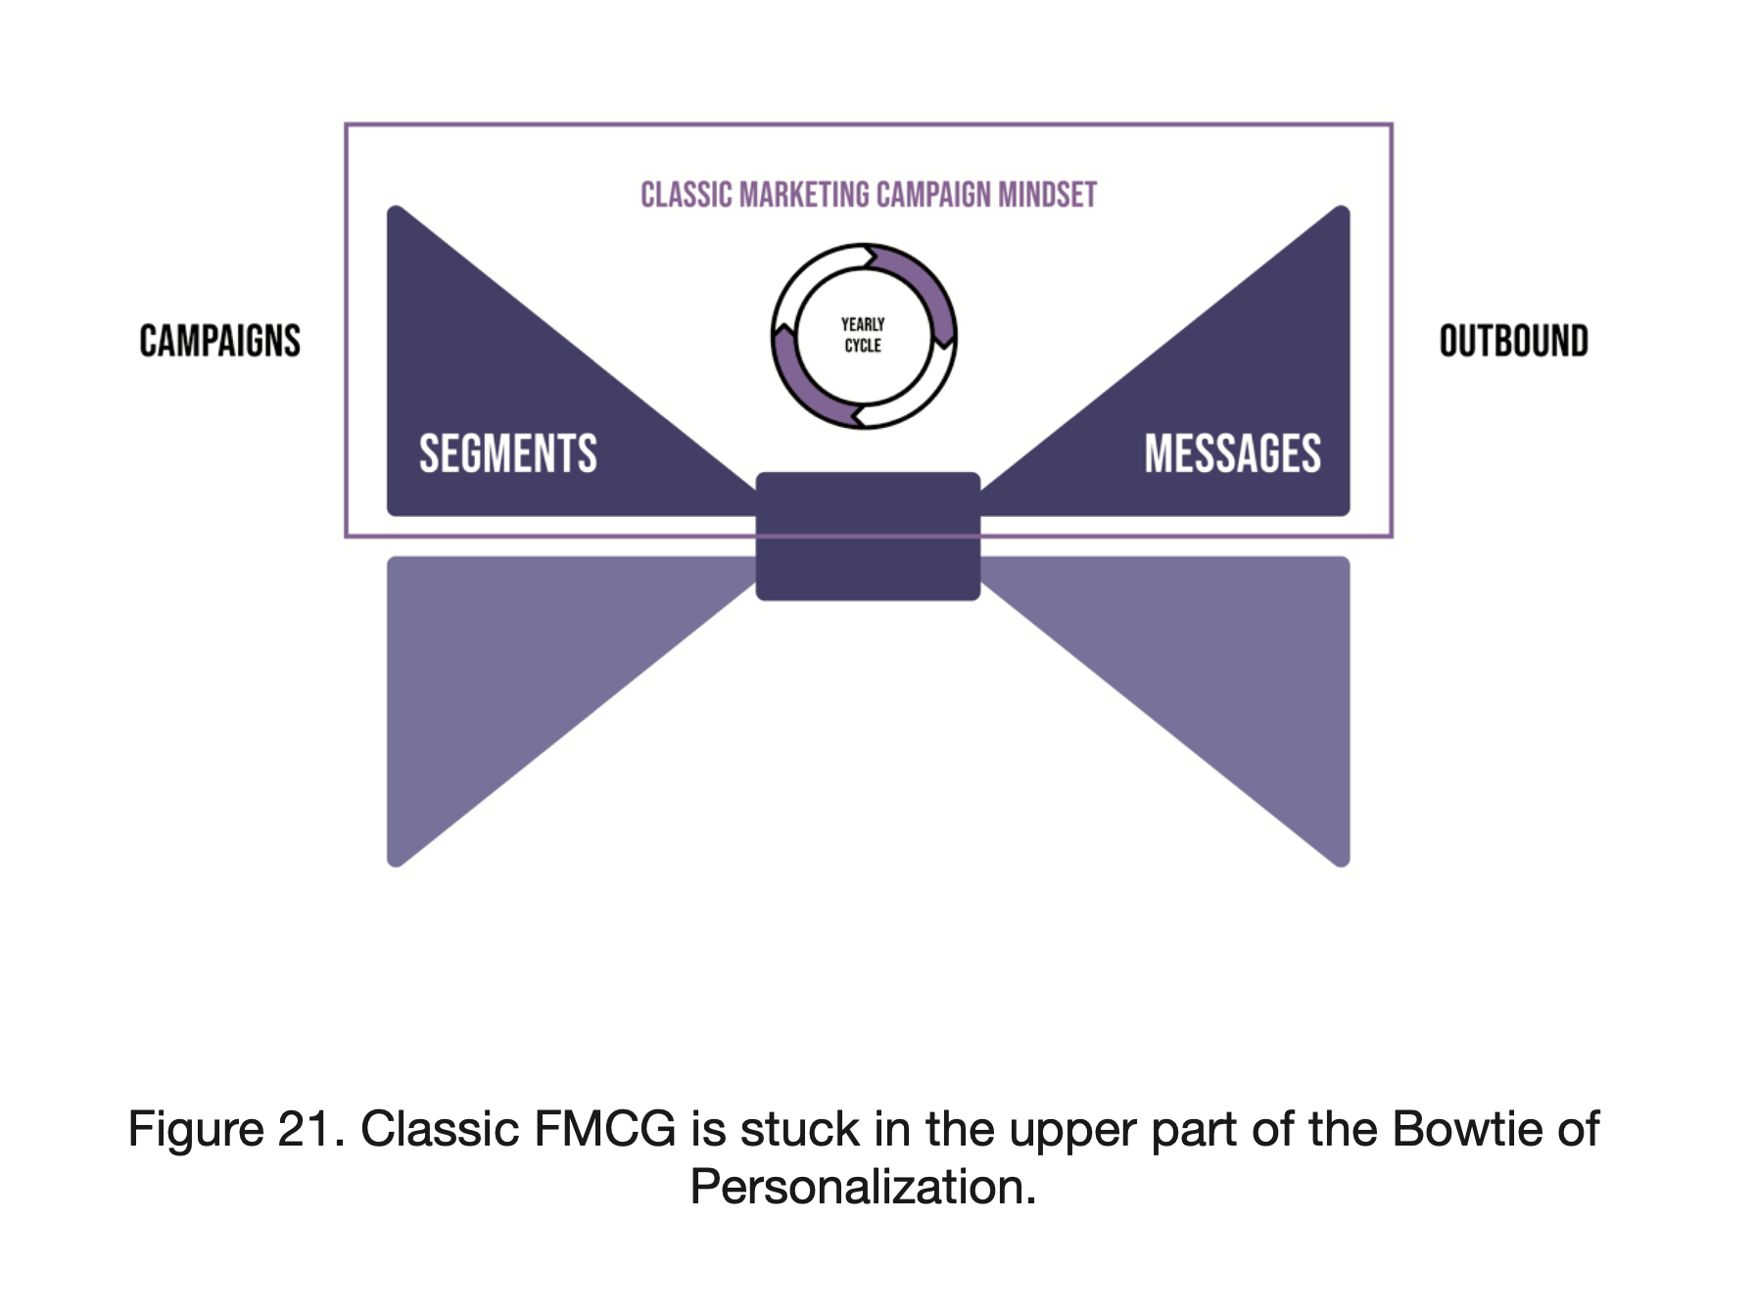

Slide 38
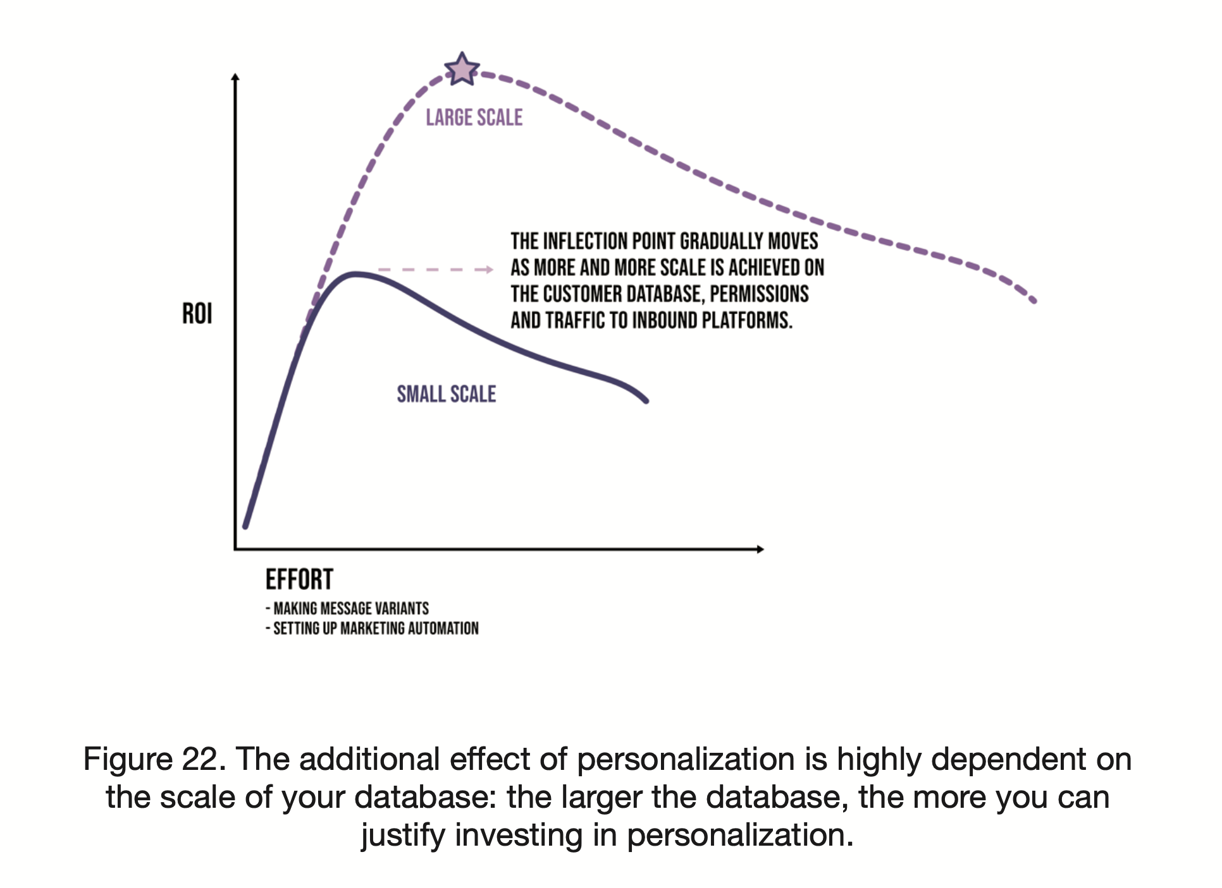

Slide 39
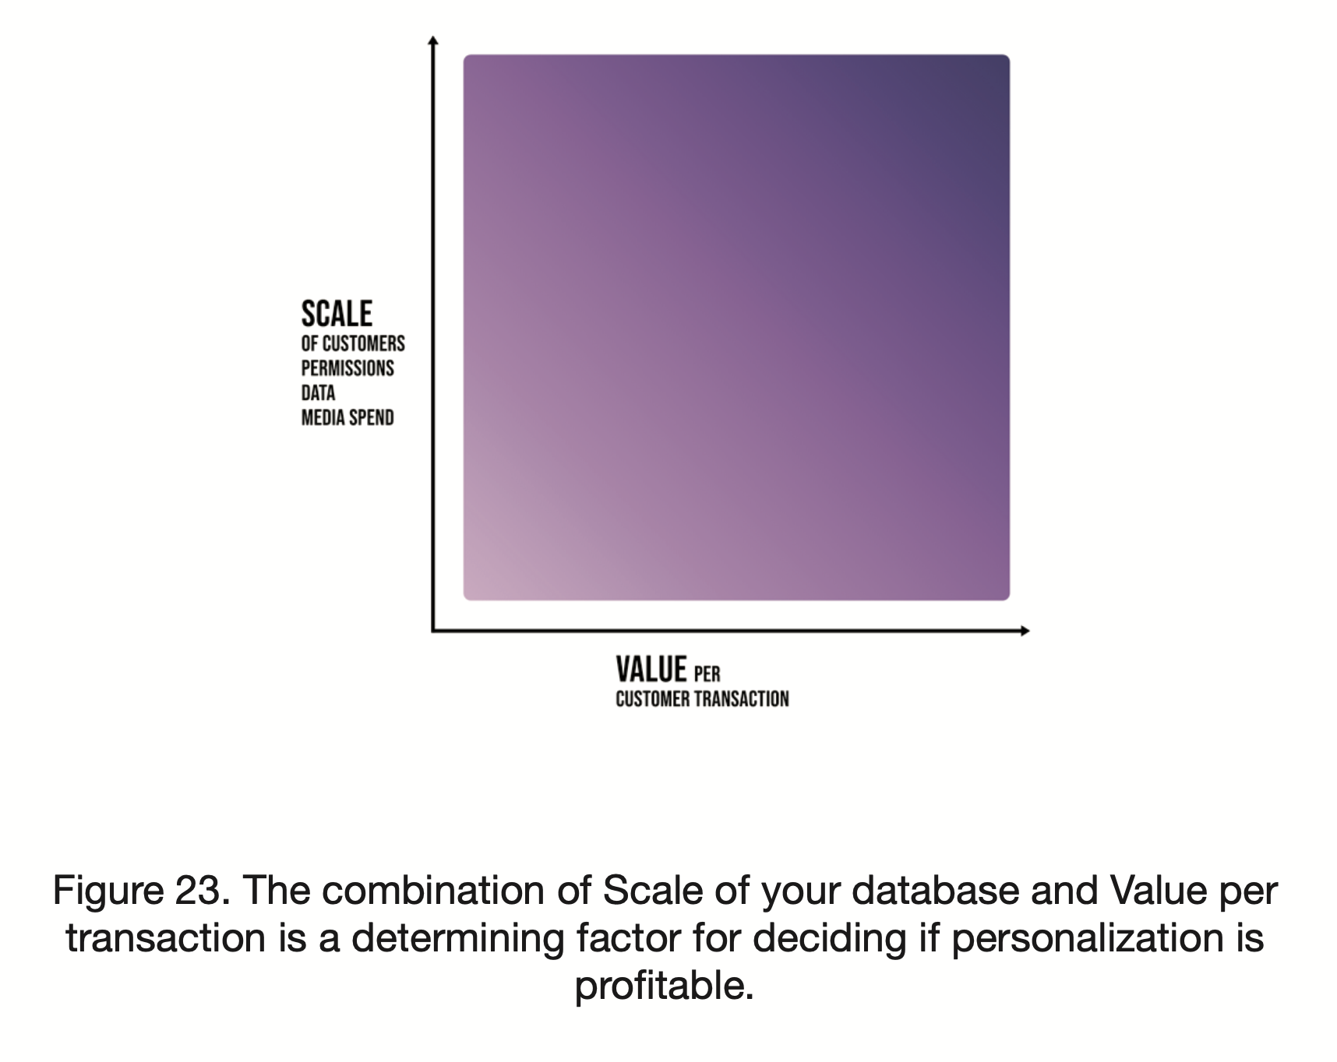

Slide 40
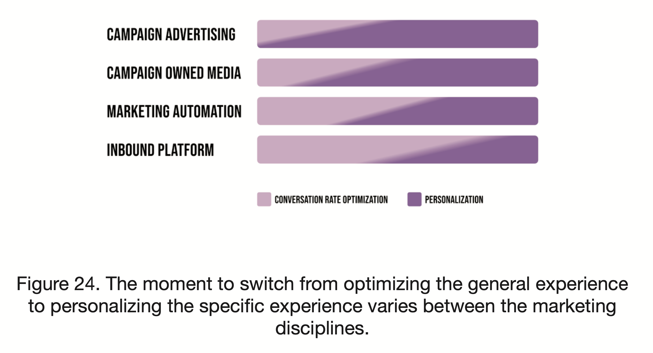

Slide 41
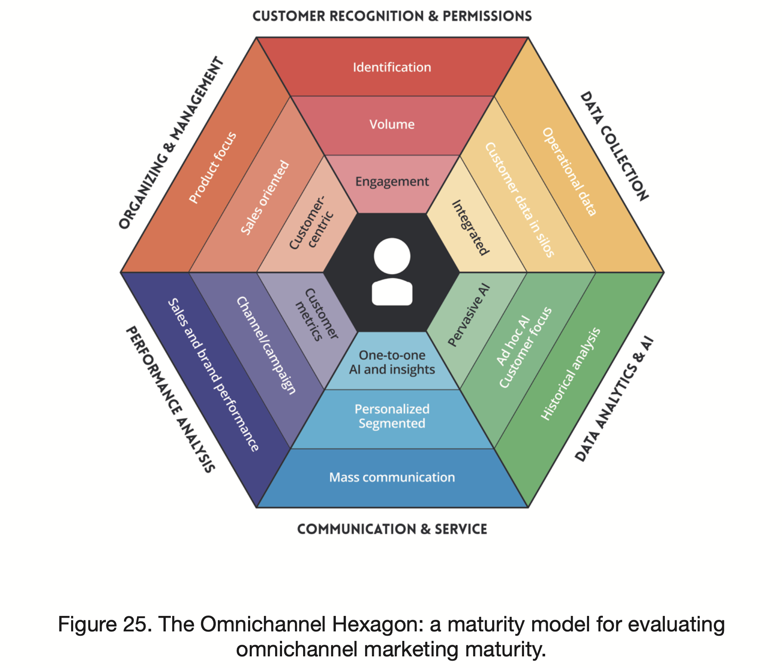

Slide 42
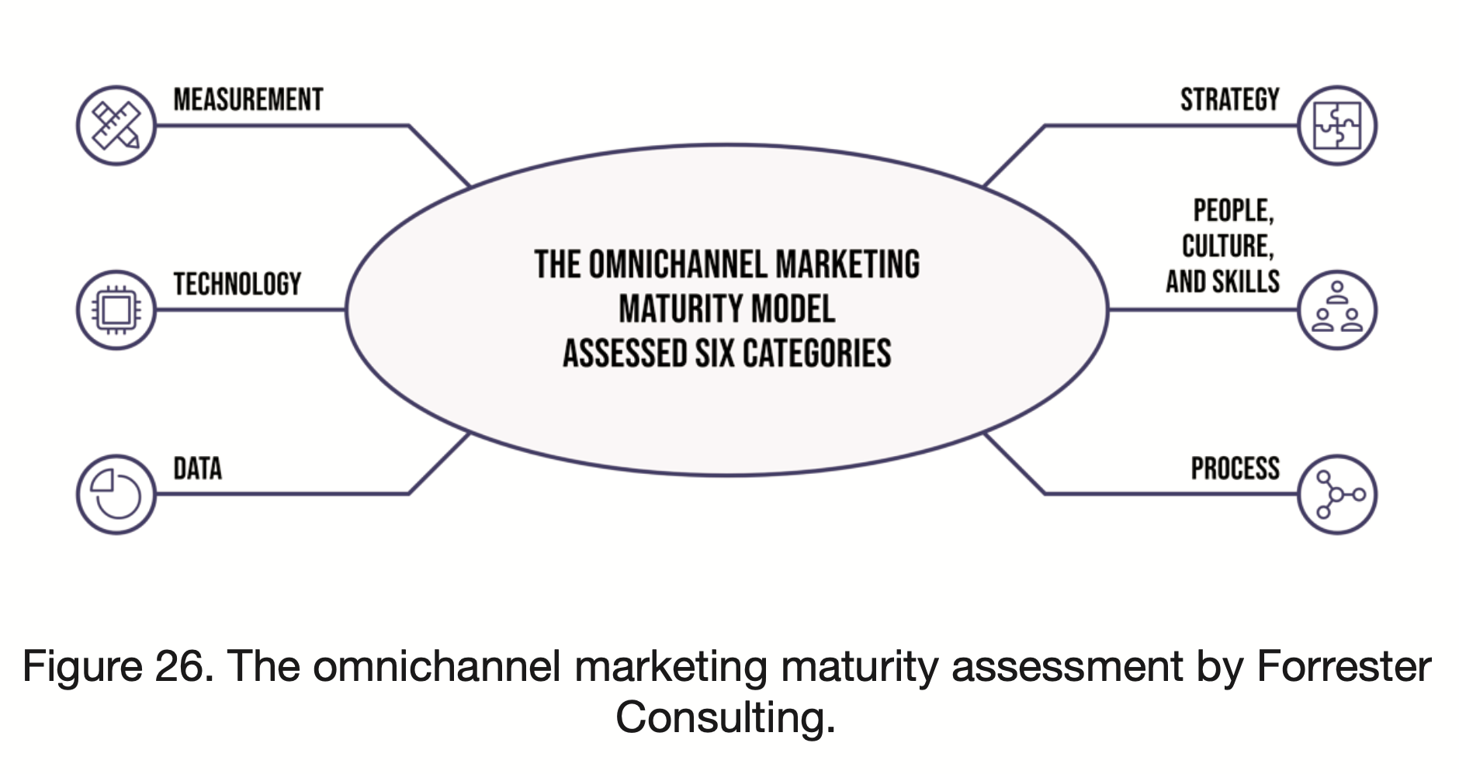

Slide 43
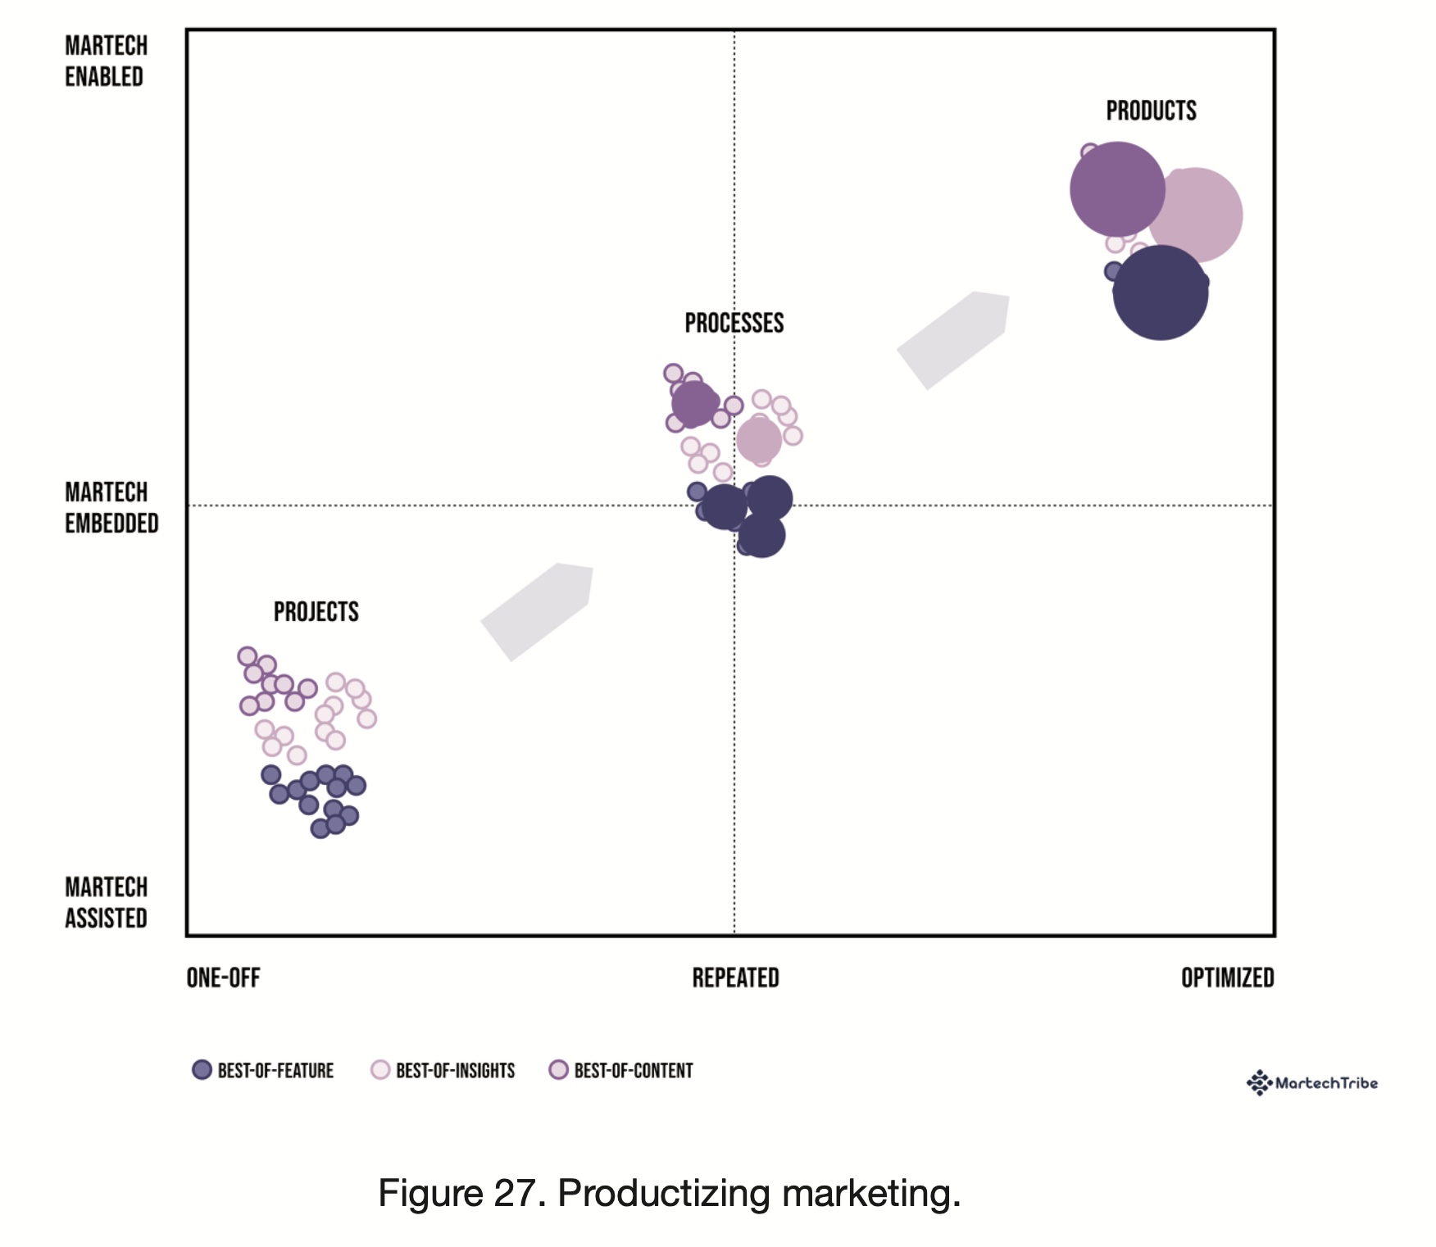

Slide 44
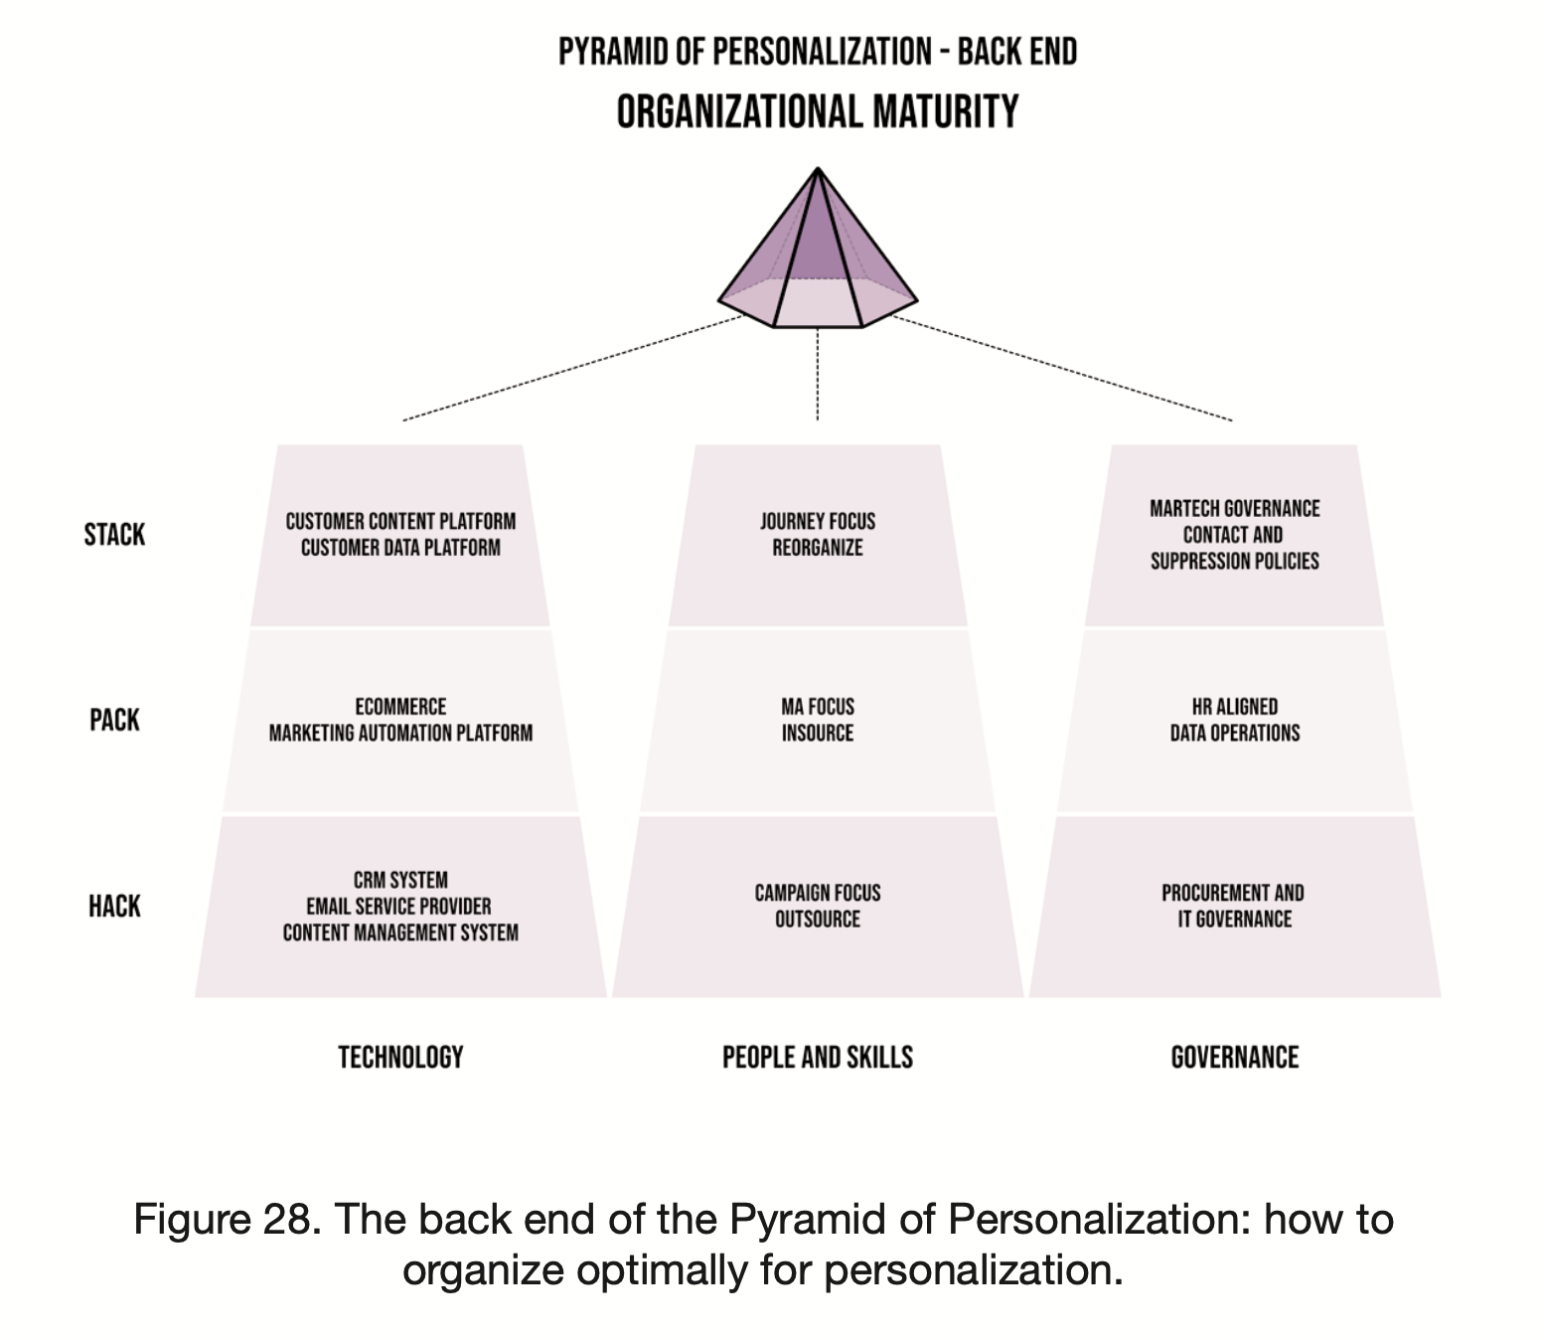

Slide 45
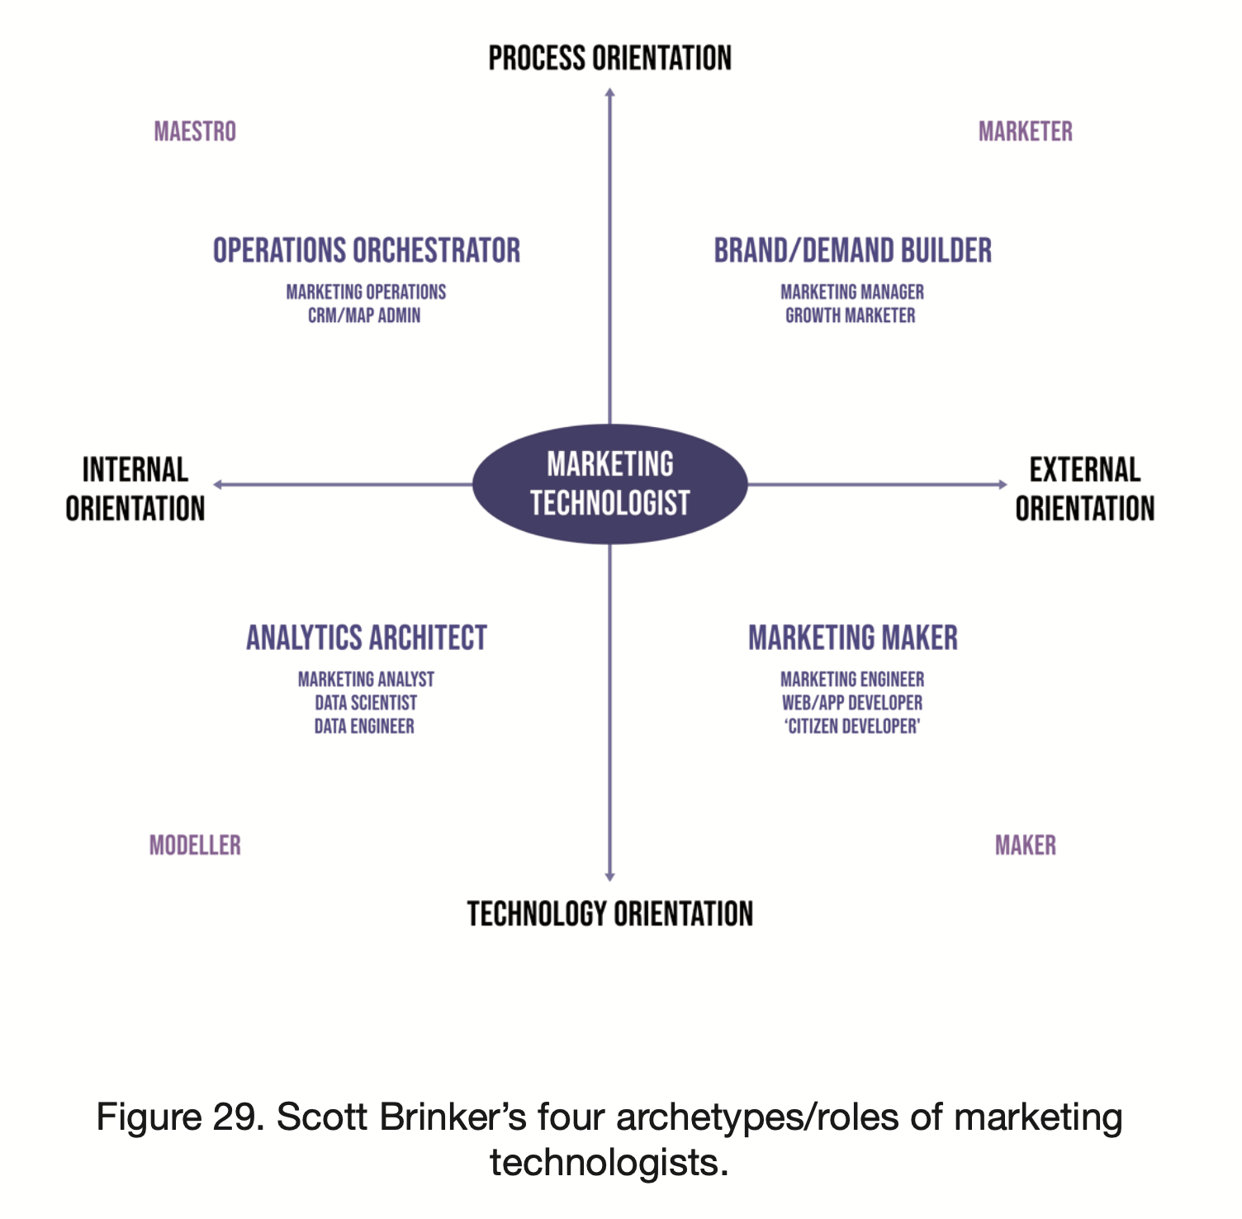

Slide 46
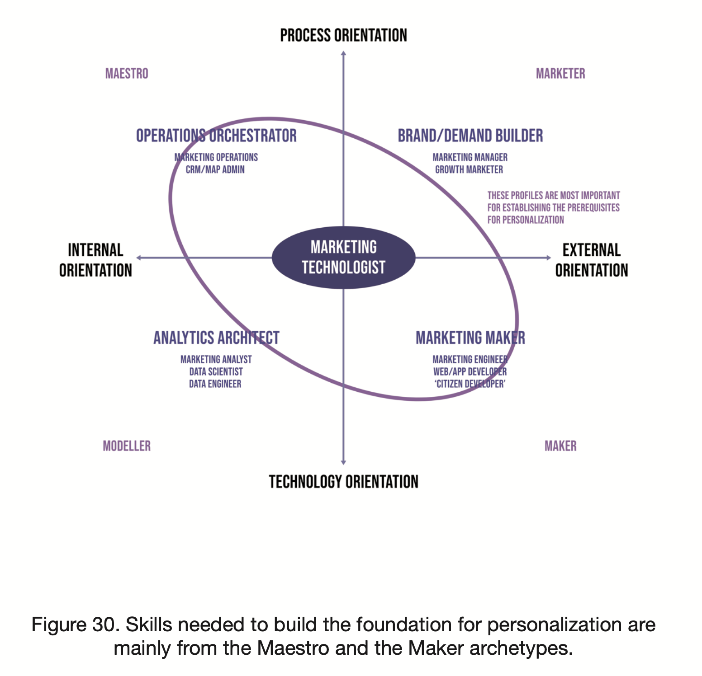

Slide 47
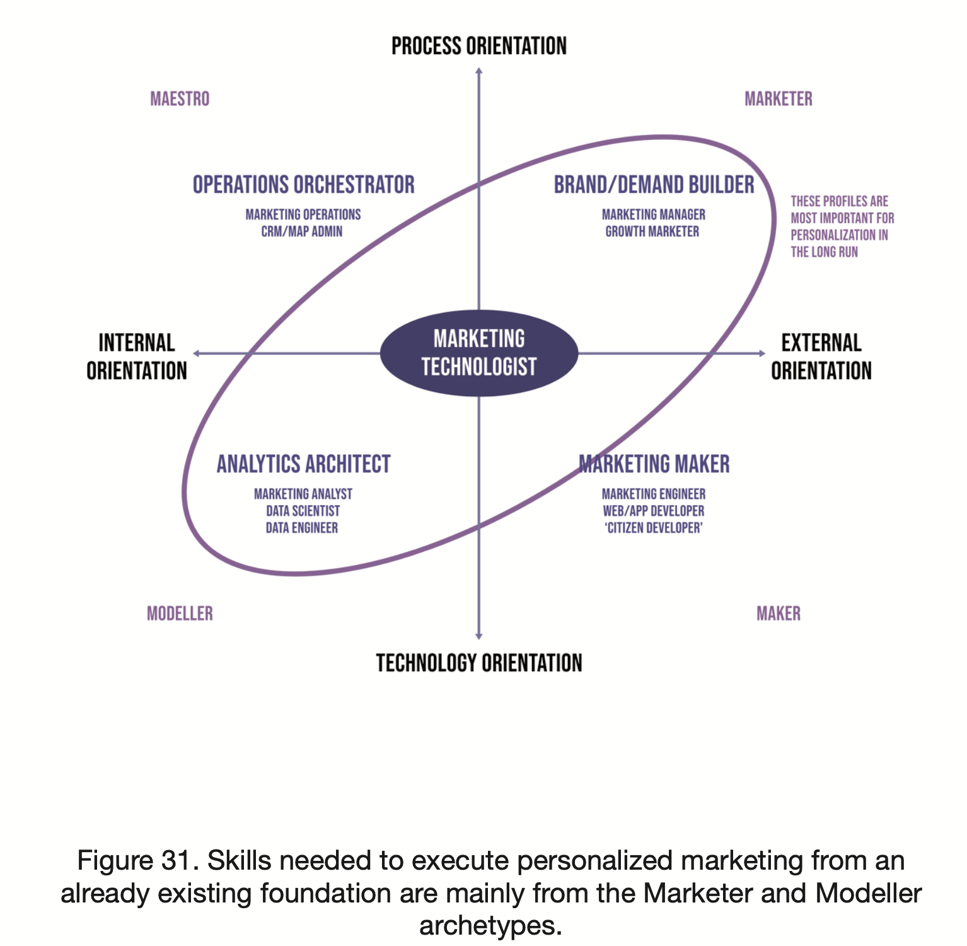

Slide 48
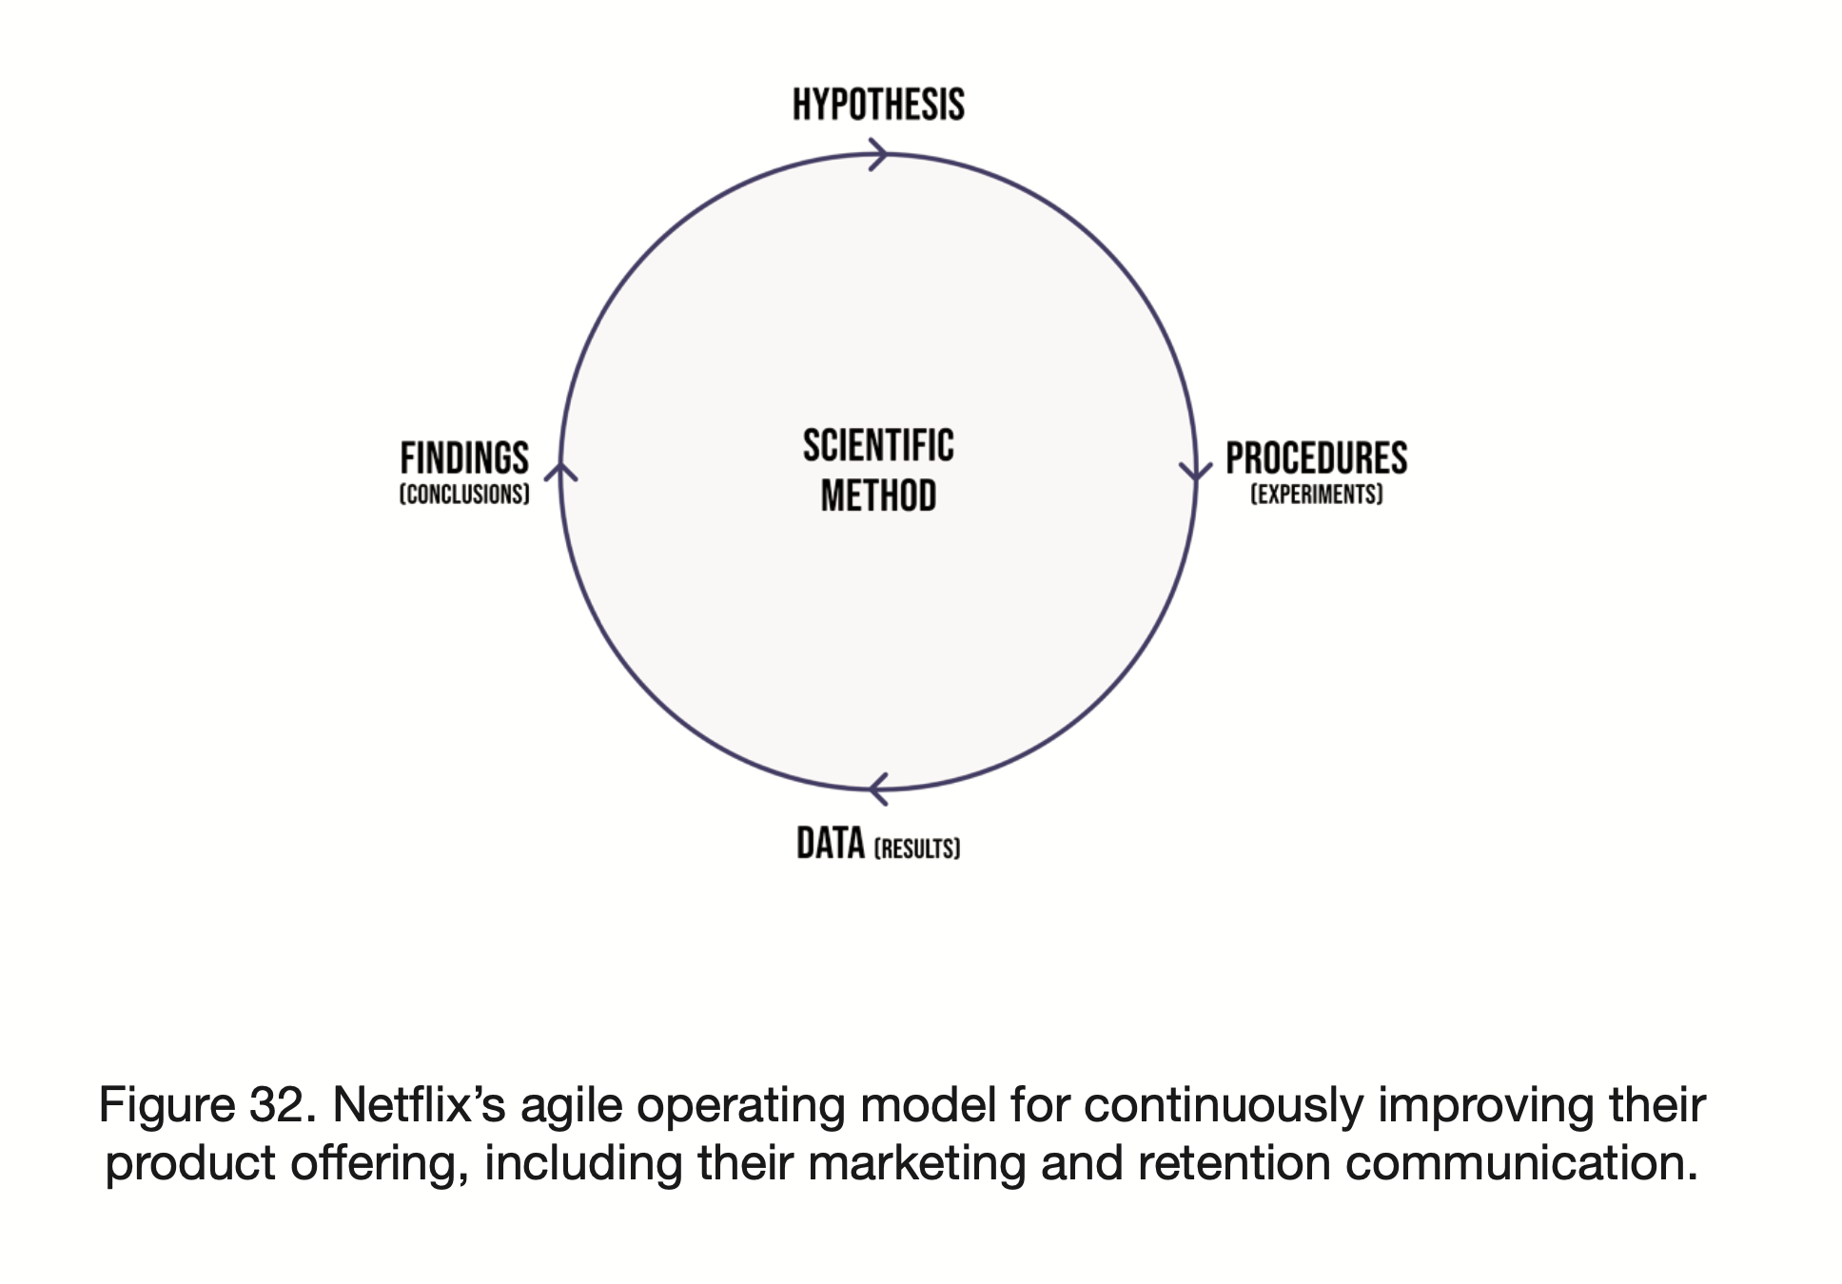

Slide 49
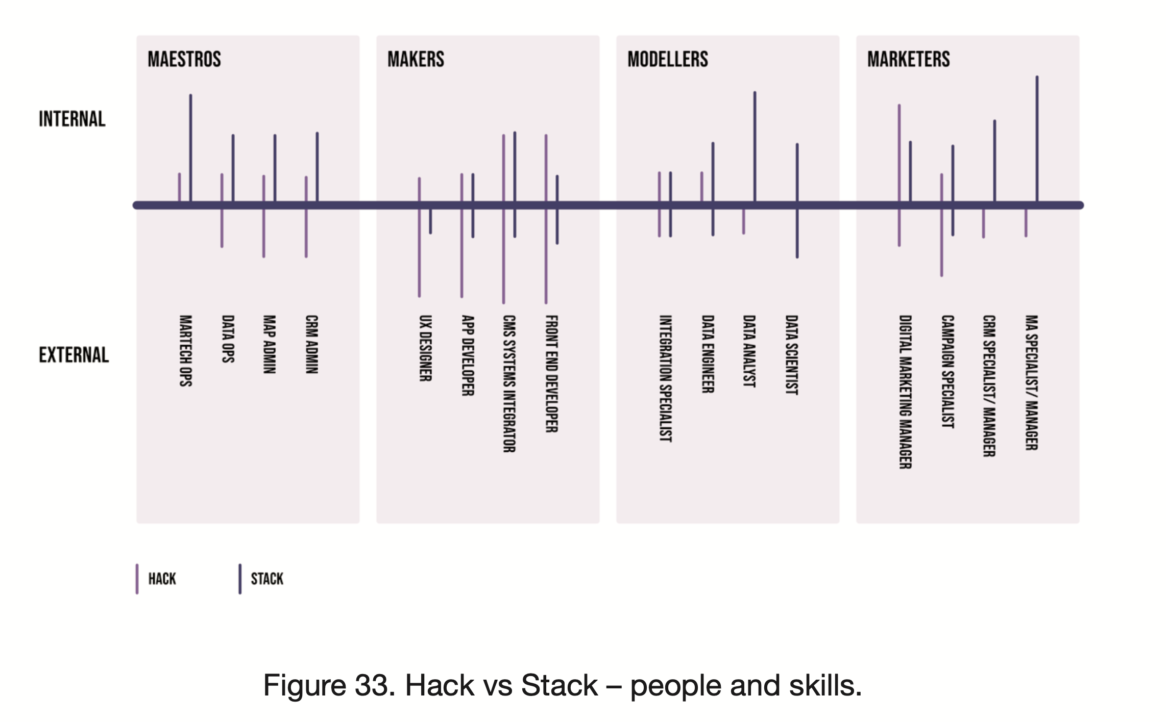

Slide 50
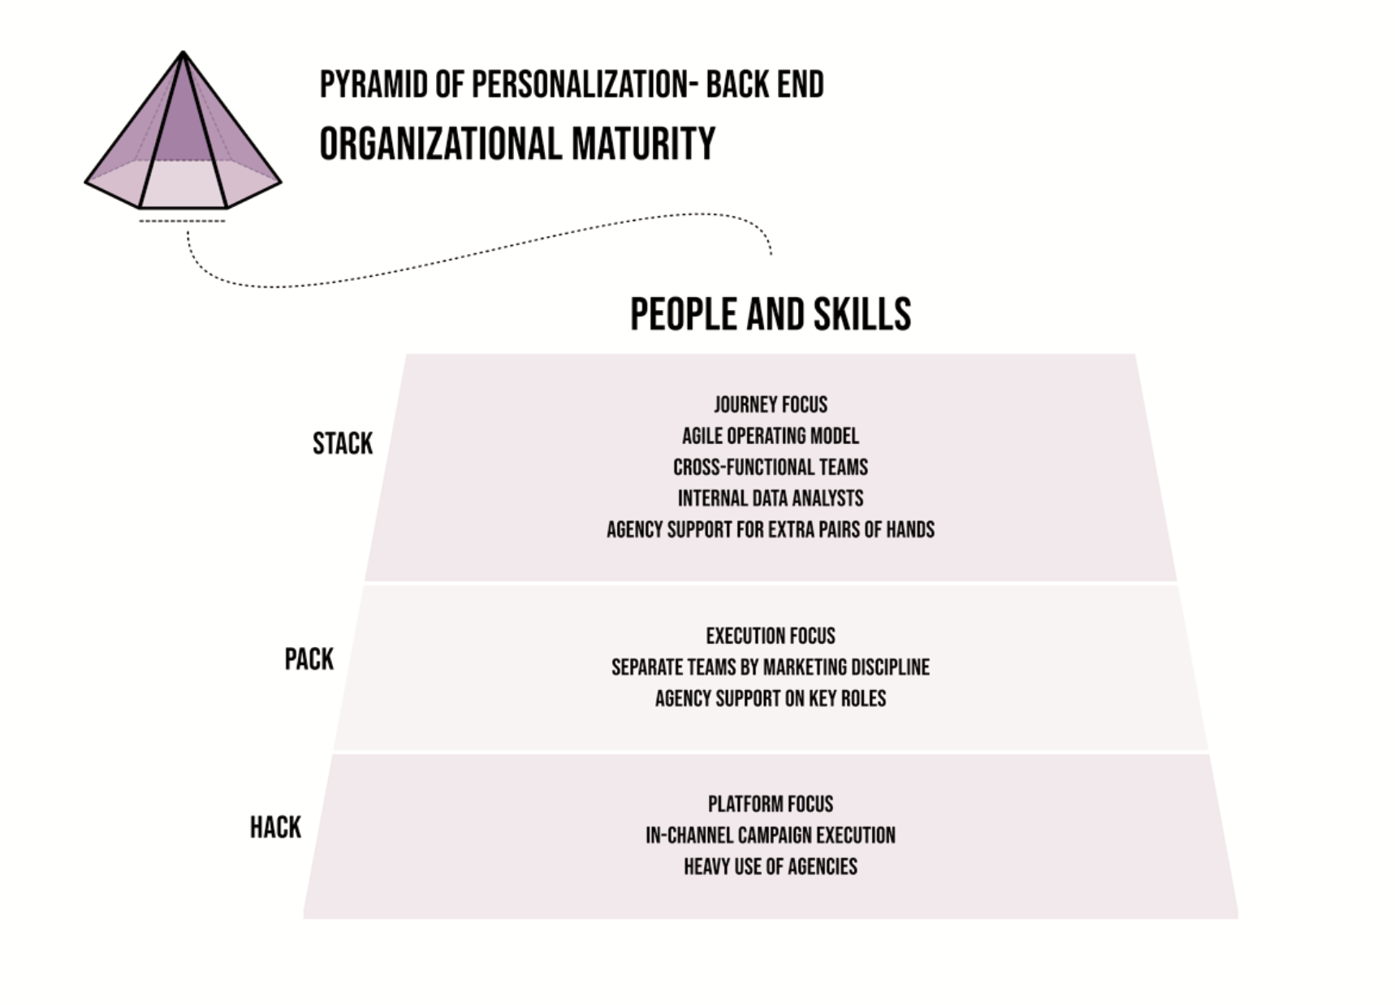

Slide 51
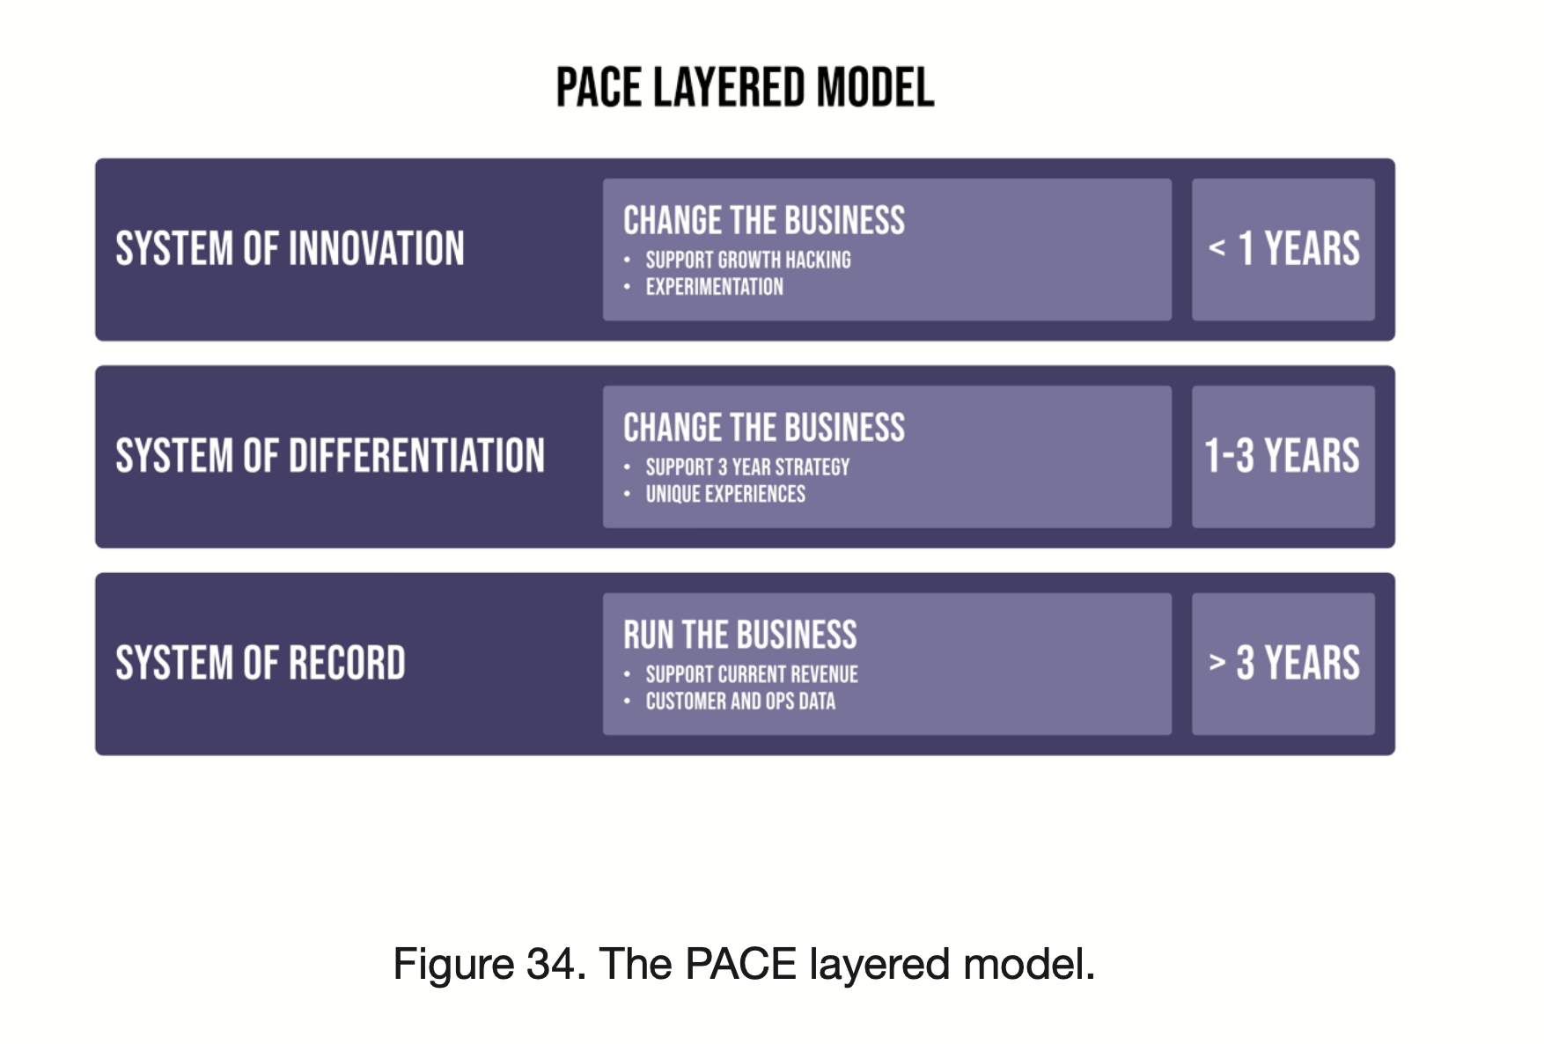

Slide 52
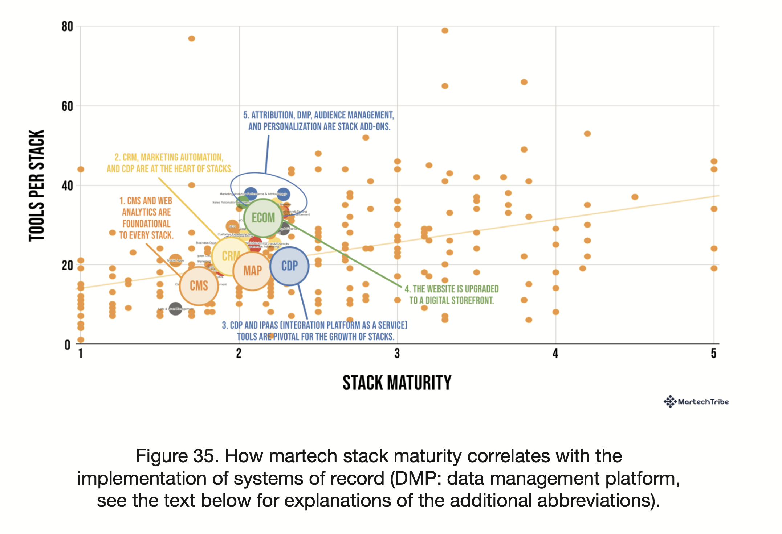

Slide 53
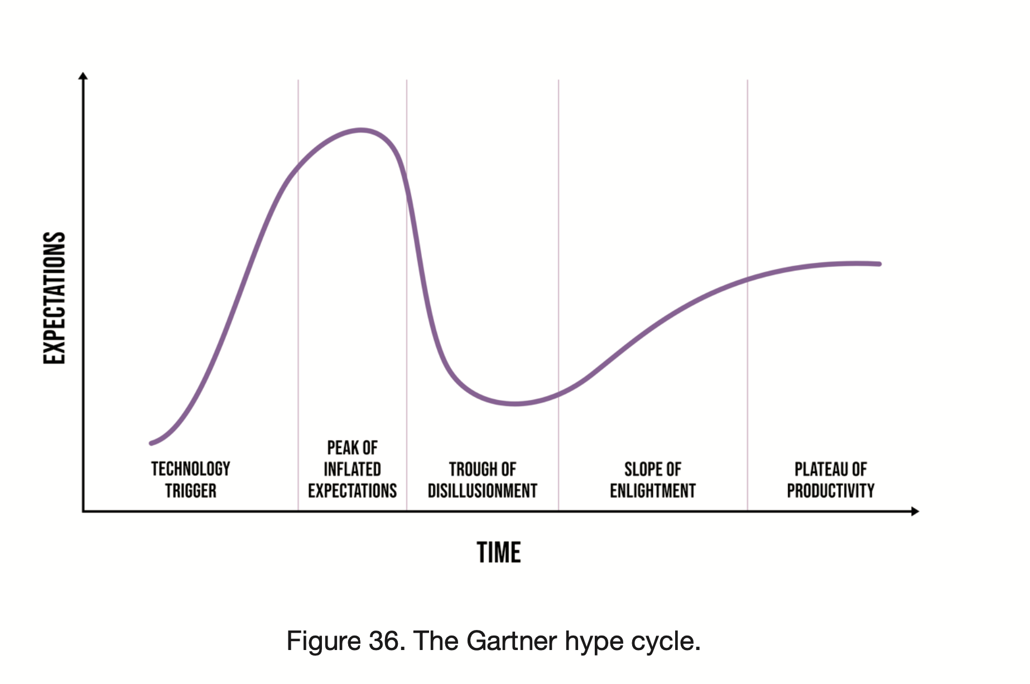

Slide 54
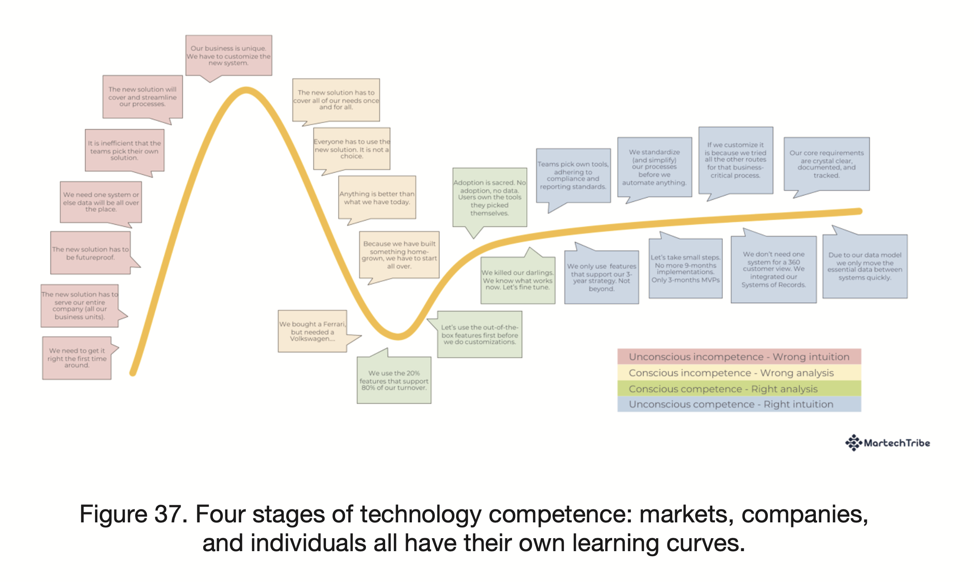

Slide 55
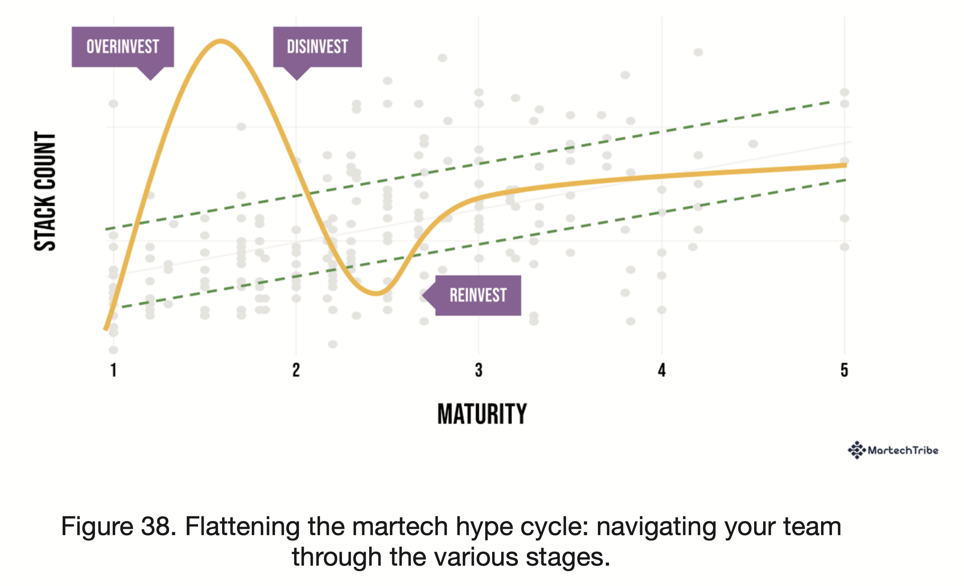

Slide 56
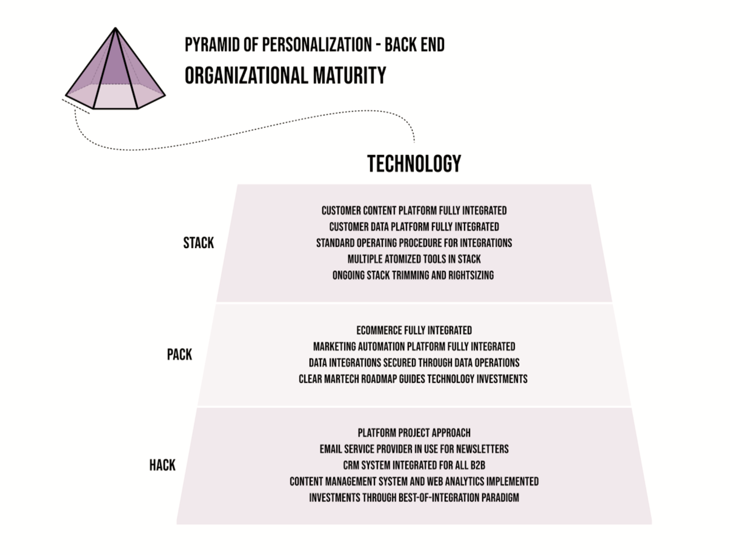

Slide 57
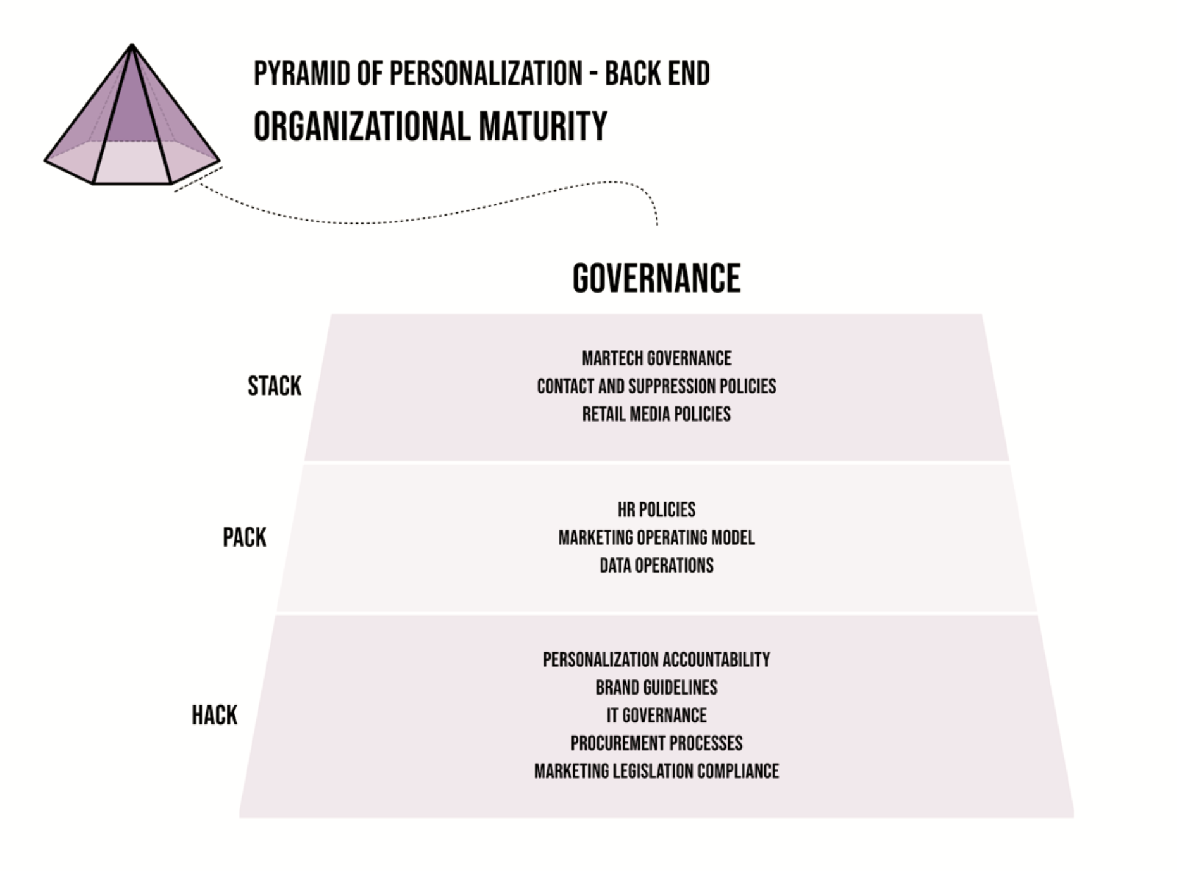

Slide 58


Slide 59


